Slide 1
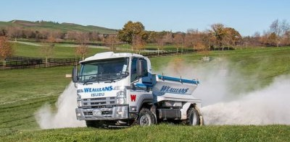
Modelling the spatial distribution of fertiliser spreading
David Baird Allister Holmes
david@vsn.co.nz allister.holmes@lincolnagritech.co.nz
1 December 2023
Biometrics in the Bay of Islands 2023
Notes:
Hi, I’m David and work part time as a statistical consultant, as work on Genstat in the rest of my time. It’s nice to be able to talk about one of the projects I’ve been involved in, as most of the work I do these days is covered by confidentiality agreements. I’ve been given approval to talk on this project so long as I don’t mention any brand names or companies. This work done with Allister Holmes, who works for Lincoln Agritech and was done to improve the uniformity of fertilizer spreading. This is a simple application with no math’s formulae, so sit back and relax.

Slide 2
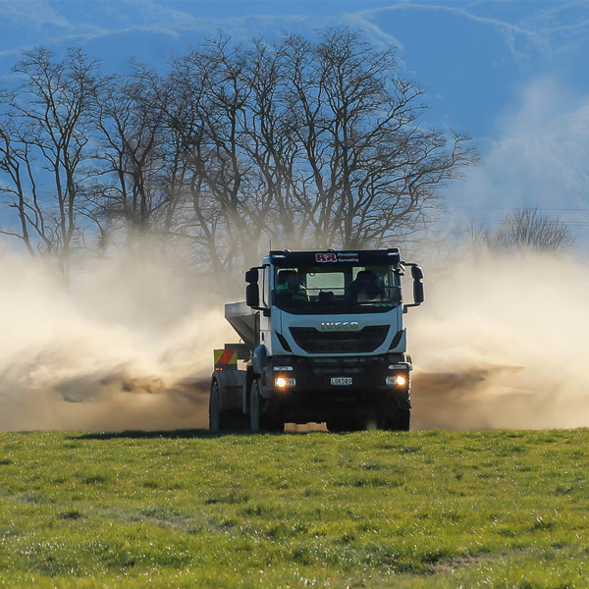
Fertiliser spreading
Mainly done from ground
Spiral travel from one corner of the field at constant bout width
Different fertilisers travel different distances, depending on particle size and spreading mechanism
Want to model full paddock distribution

Slide 3
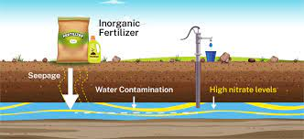
Uniform distribution increasing in importance
Ecological imperatives to reduce over-fertilized spots
Problems with nitrification of ground water
Fertiliser leaches from where plants can’t use it

Slide 4
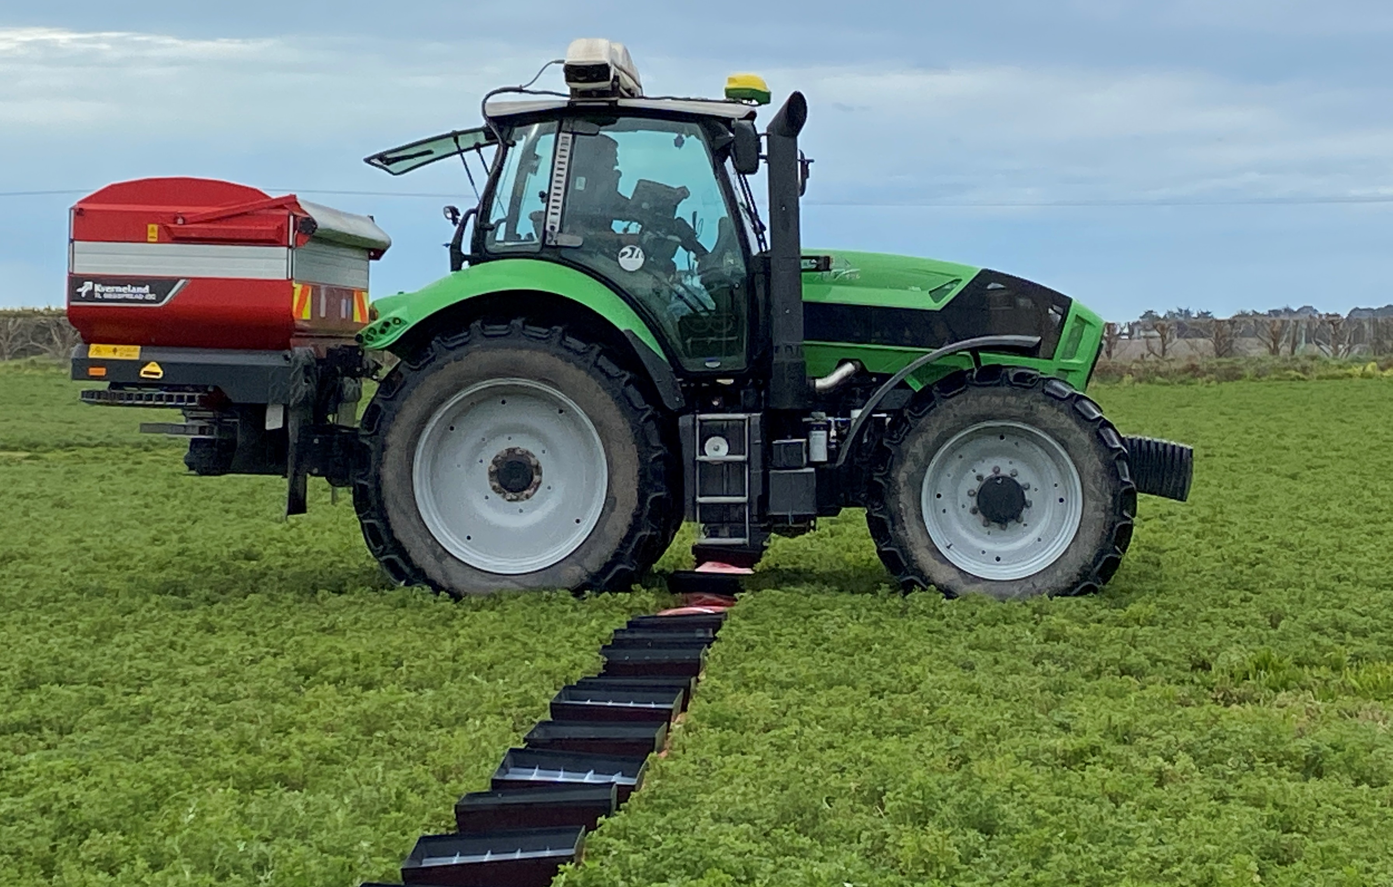
Trial to model fertiliser distribution
Two regions of NZ
Two spreaders/region
2 companies in Waikato
2 farmers in South Canterbury
Different fertilisers and rates
5 replicate lines of trays
18 metres catchment of either side of centre of run
-1 and 1 metre spots missing (due to wheel tracks)
Measured weight per trap and sometimes components

Slide 5
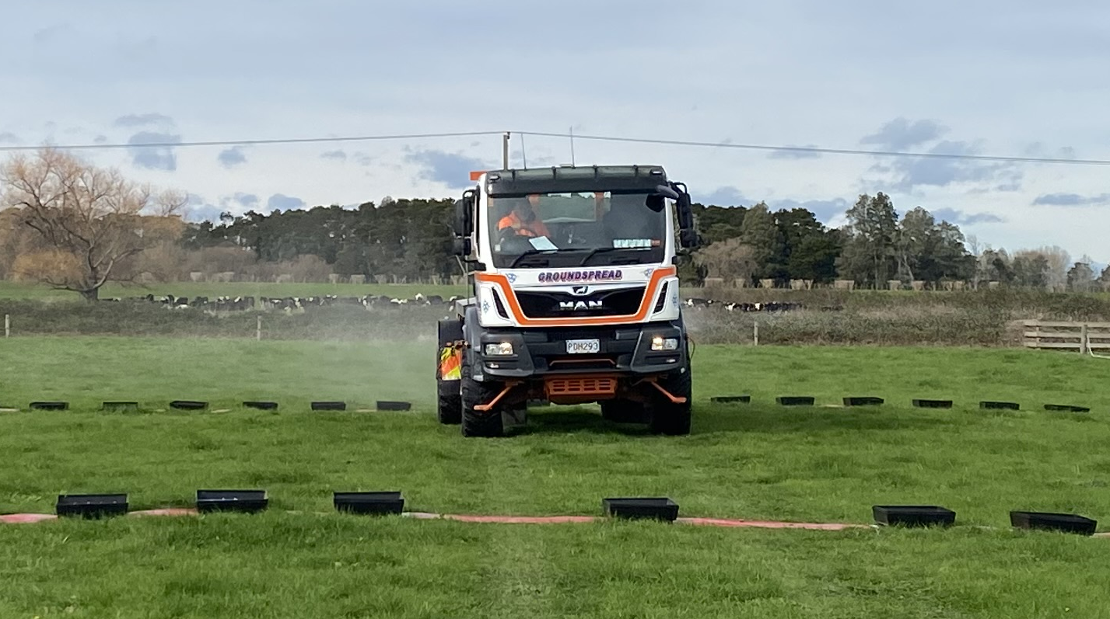
Truck running past traps

Slide 6
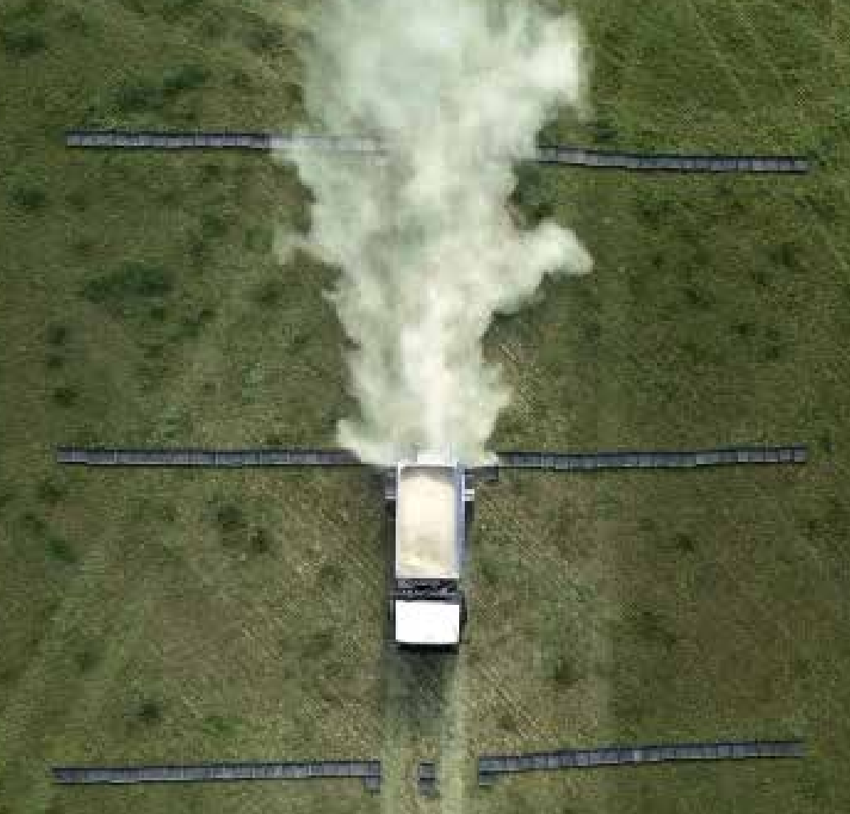
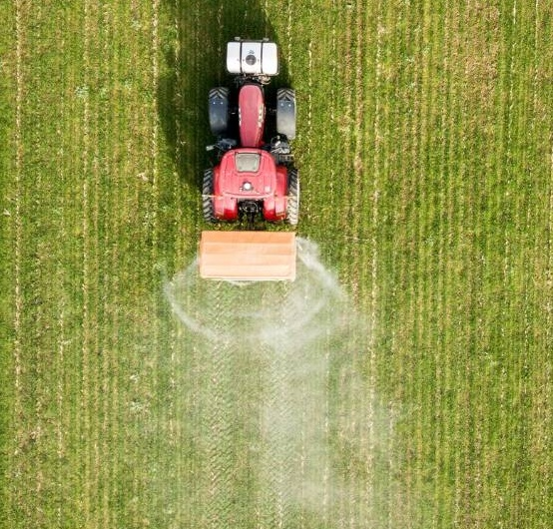
Spreaders from above

Slide 7
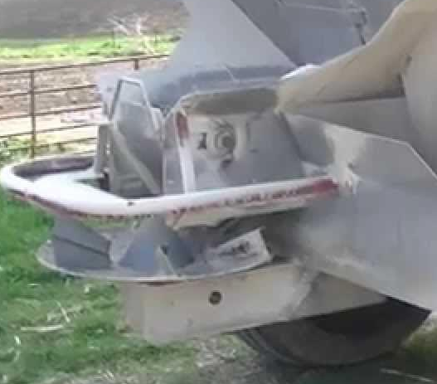
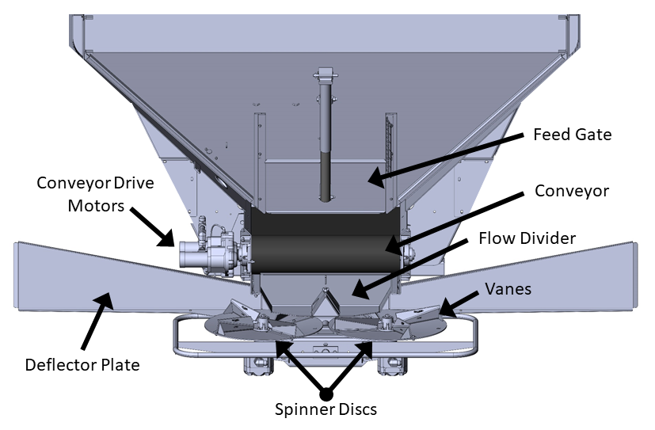
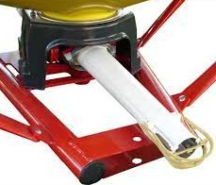
Spreader mechanism

Slide 8
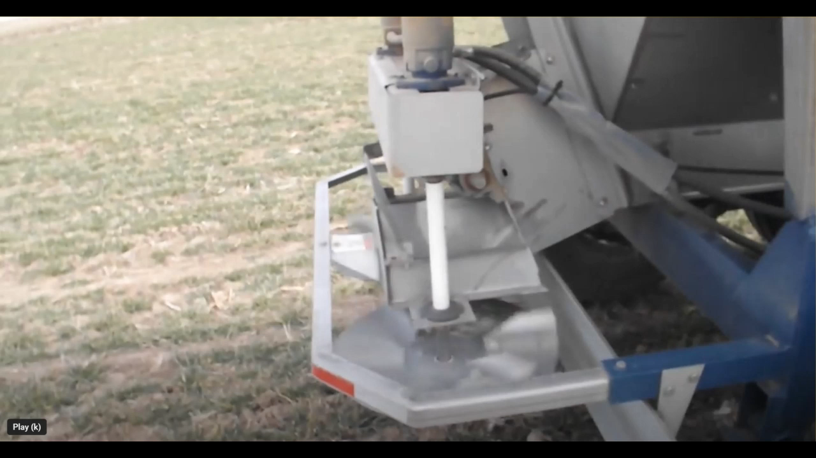
Spreader mechanism

Slide 9
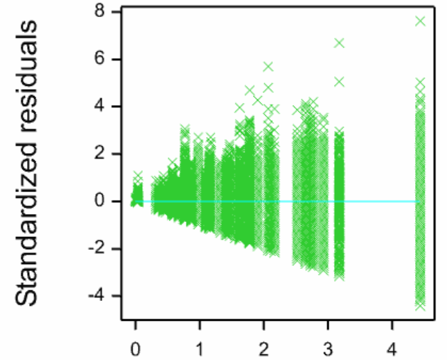
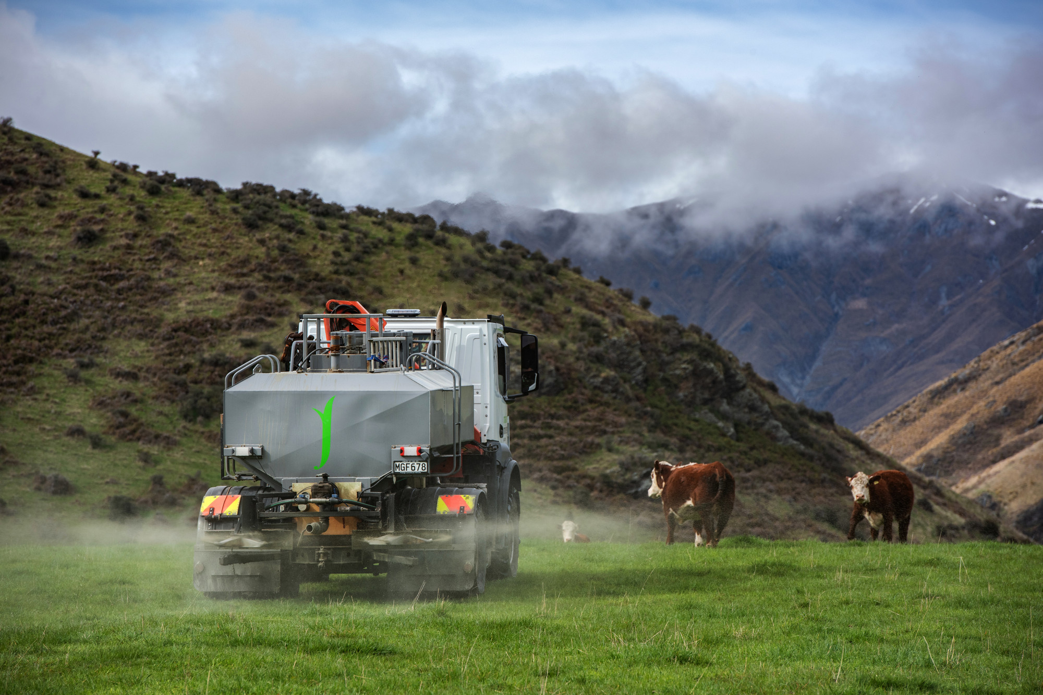
Modelling trap weight
As expected, variance is proportional to mean
Use GLM with Poisson distribution, log-link and estimate dispersion
Fitted values

Slide 10
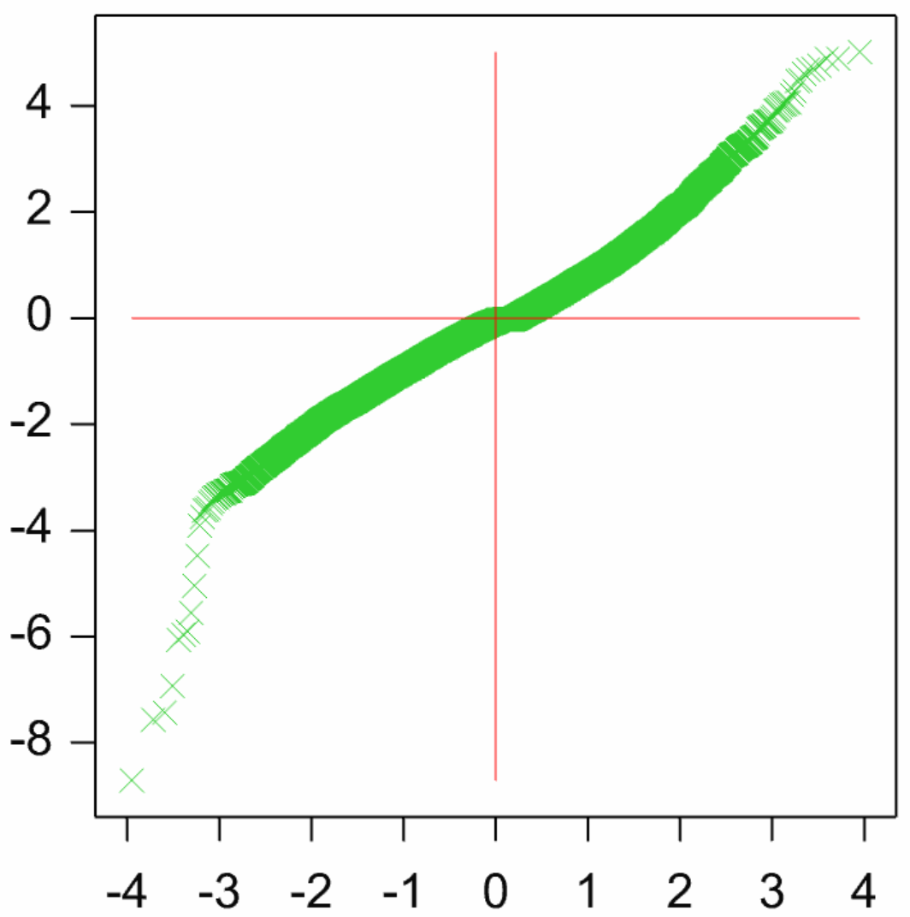
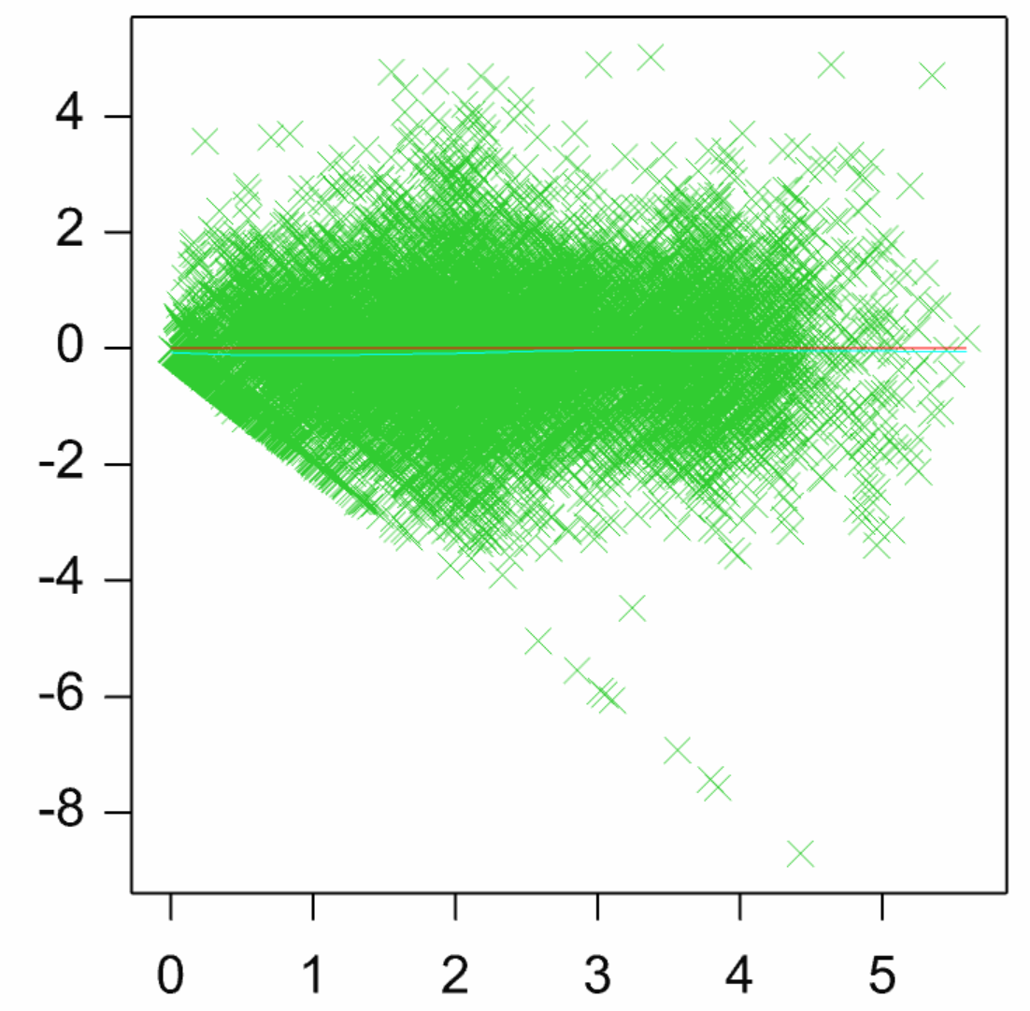
Poisson GLM works well
Standardized residuals
Standardized residuals
Normal score
Fitted values
Some large negative residuals due to a few empty trays
Notes:
Standardized residuals identified plots with missing decimal points and other that the values had been entered in the wrong place.

Slide 11
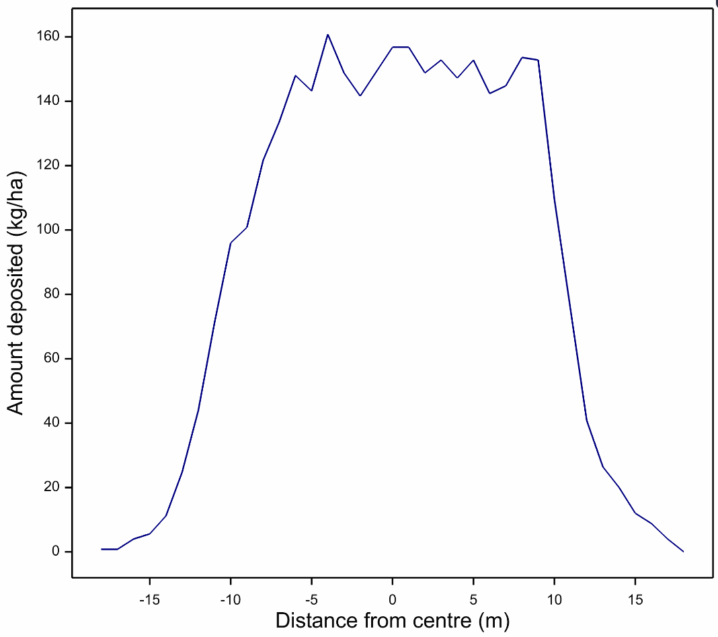
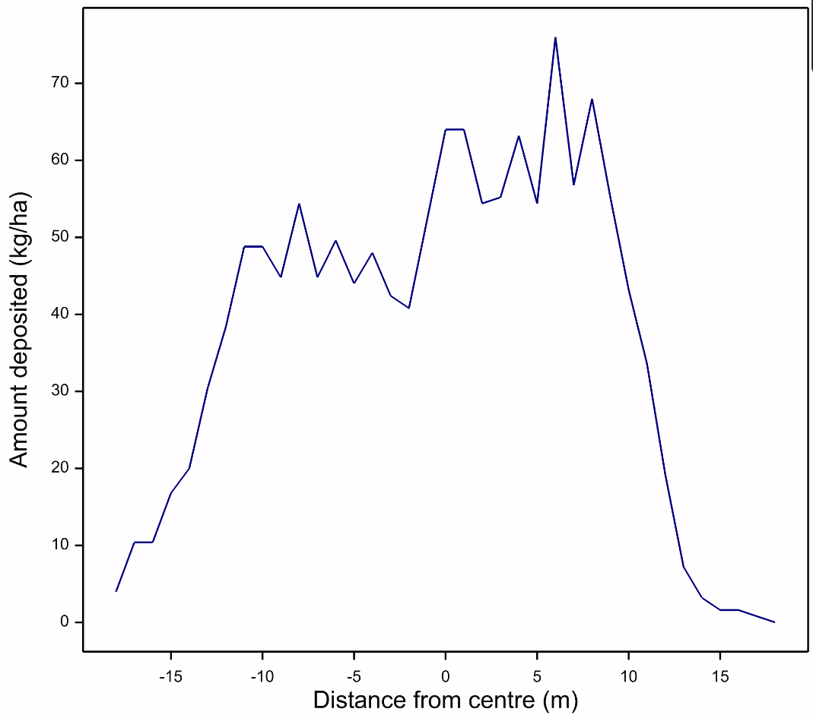
Fitted distributions varied in shape

Slide 12
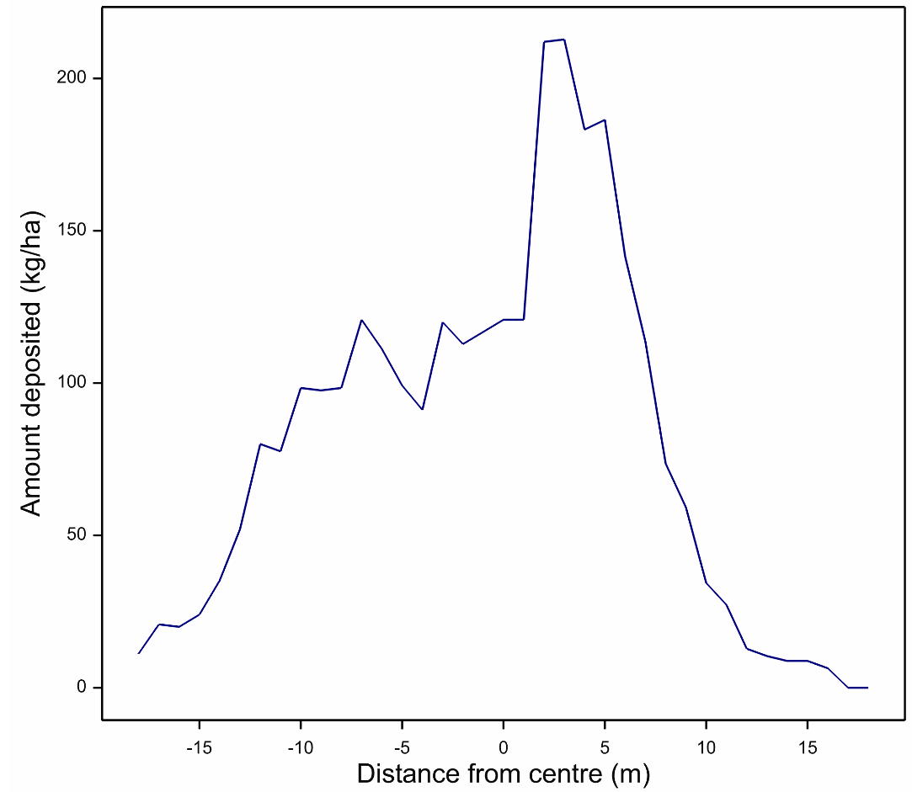
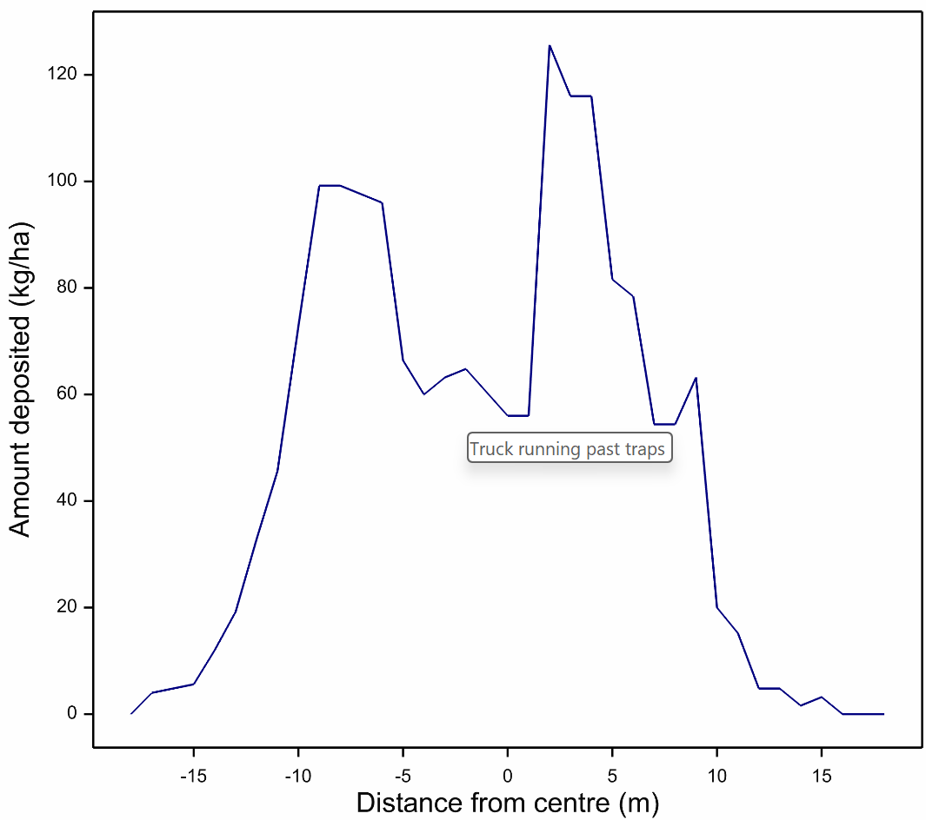
Non symmetrical distributions

Slide 13
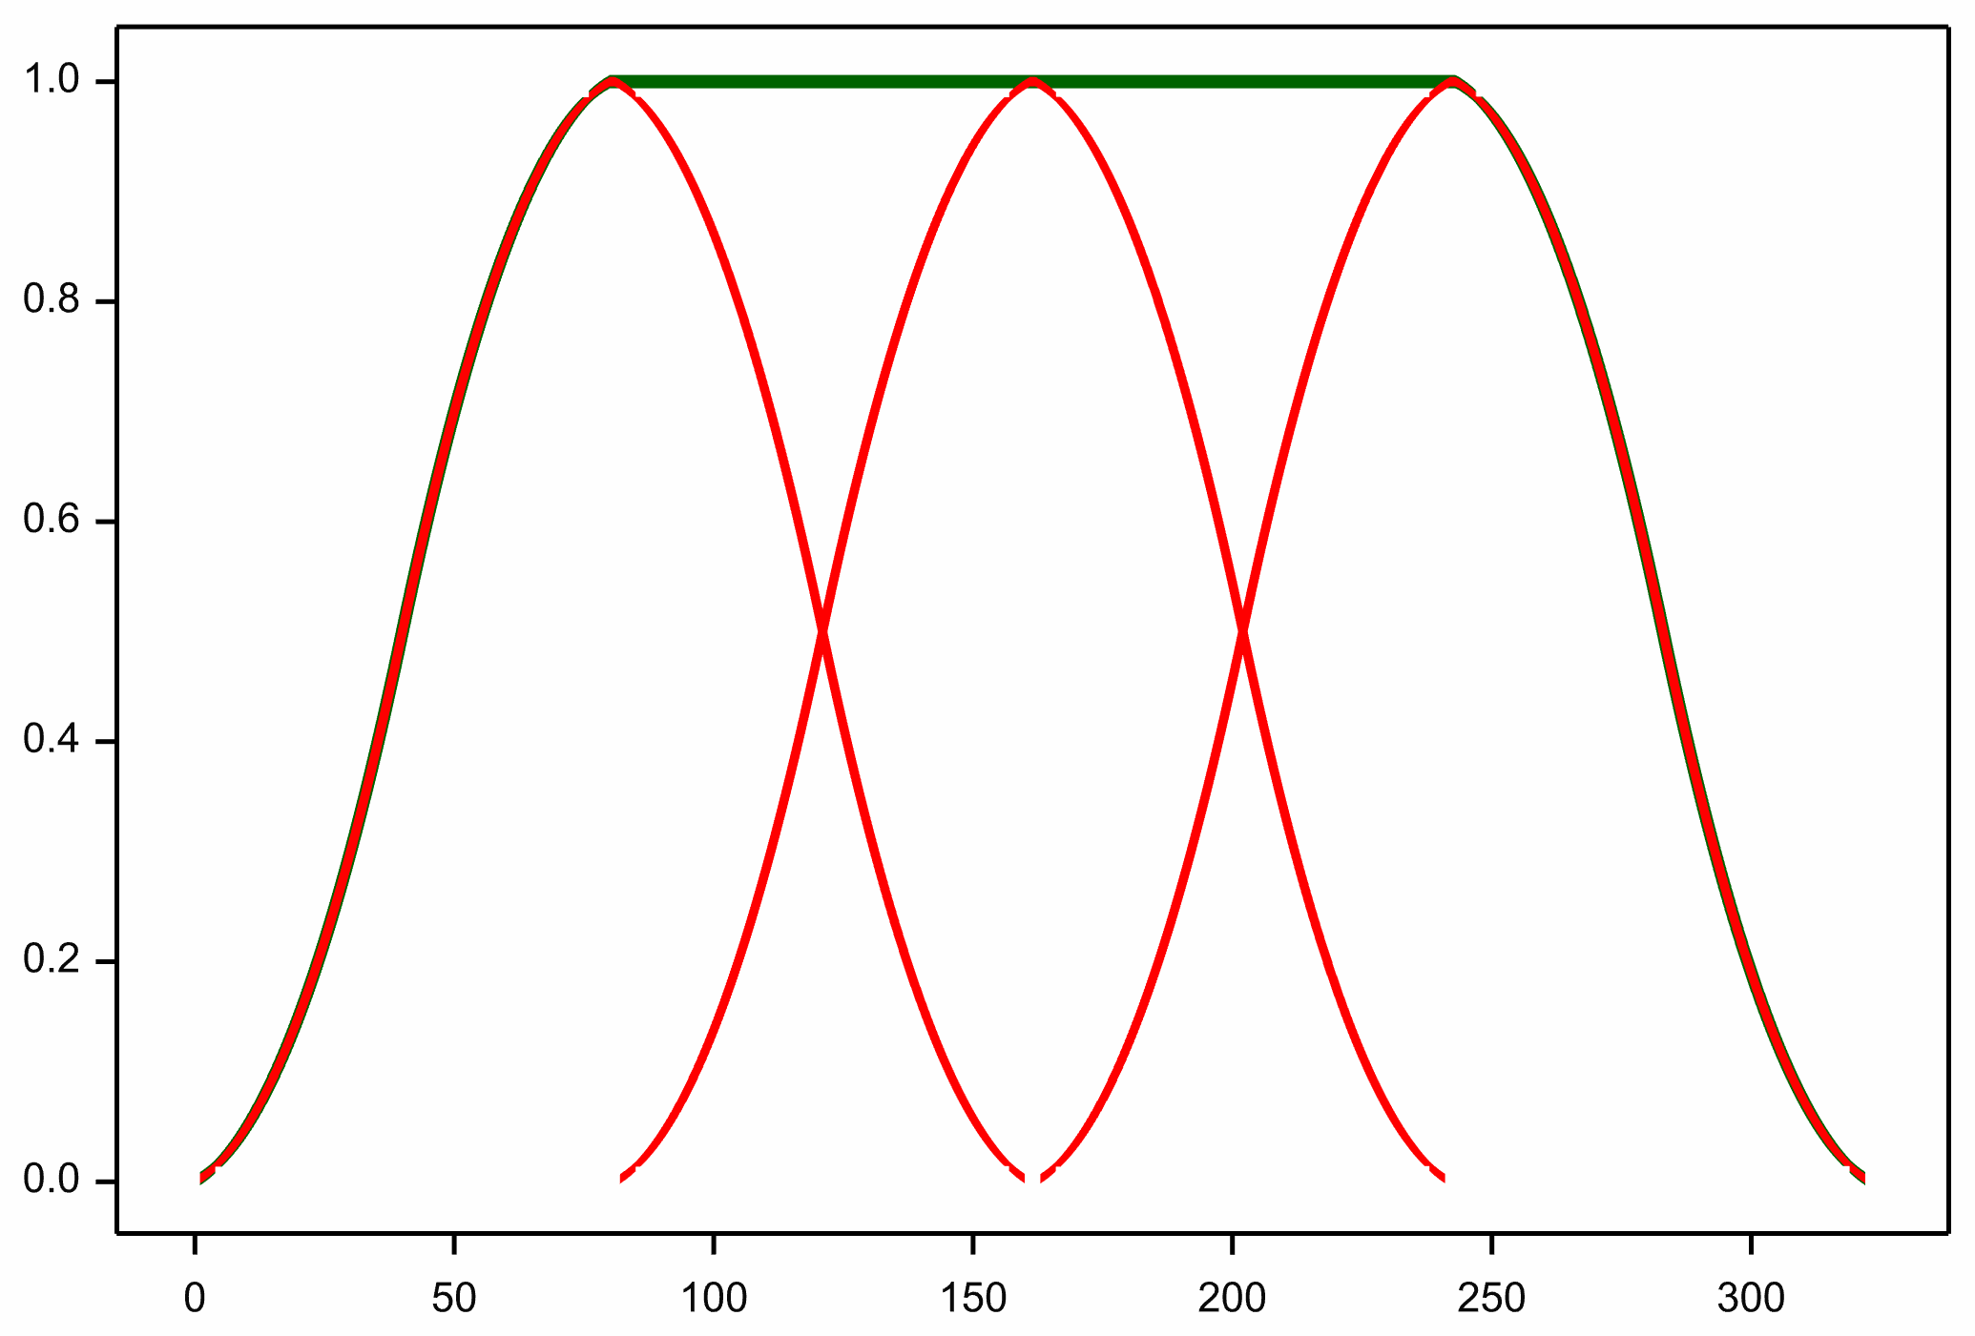
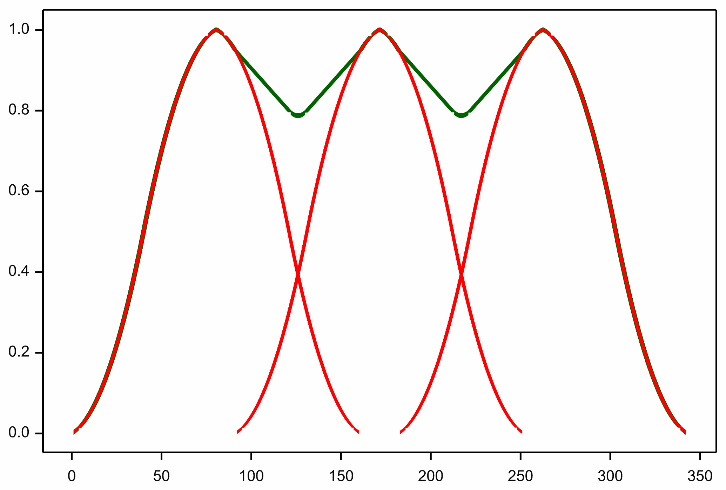
Overlapping passes
The width between tracks is less than the spread width
Deposition will accumulate on overlapped areas
Ideally the tails will add to give reasonable coverage

Slide 14
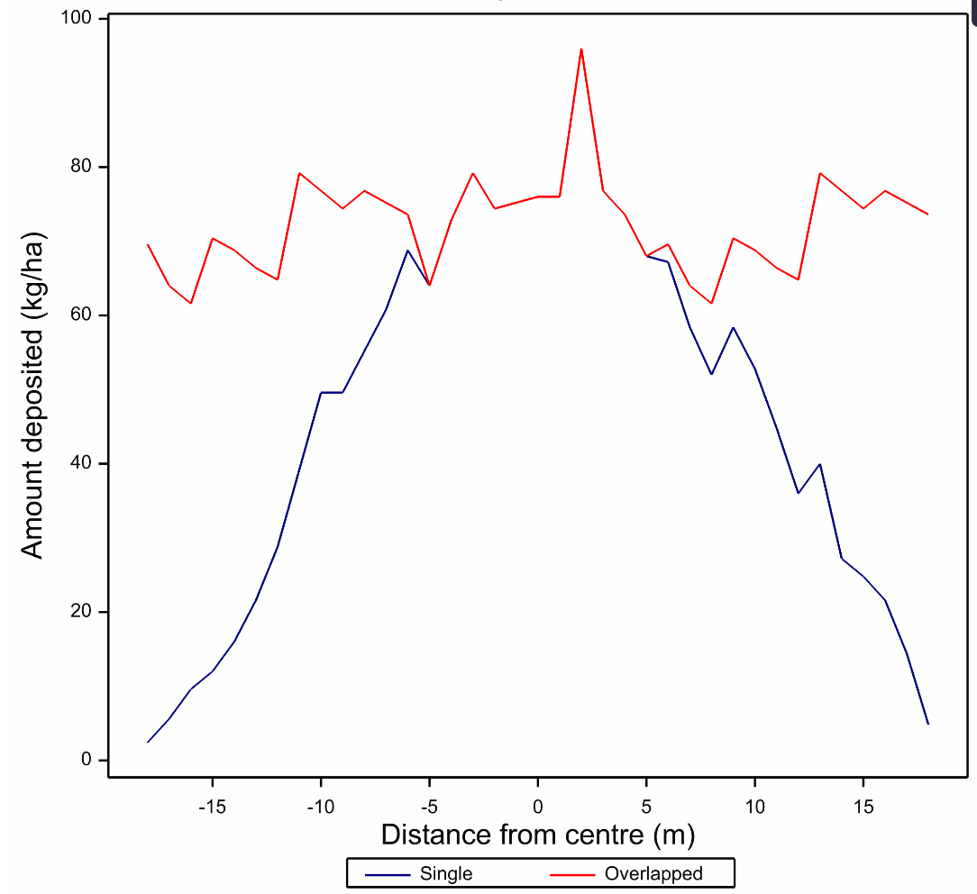
Good overlap

Slide 15
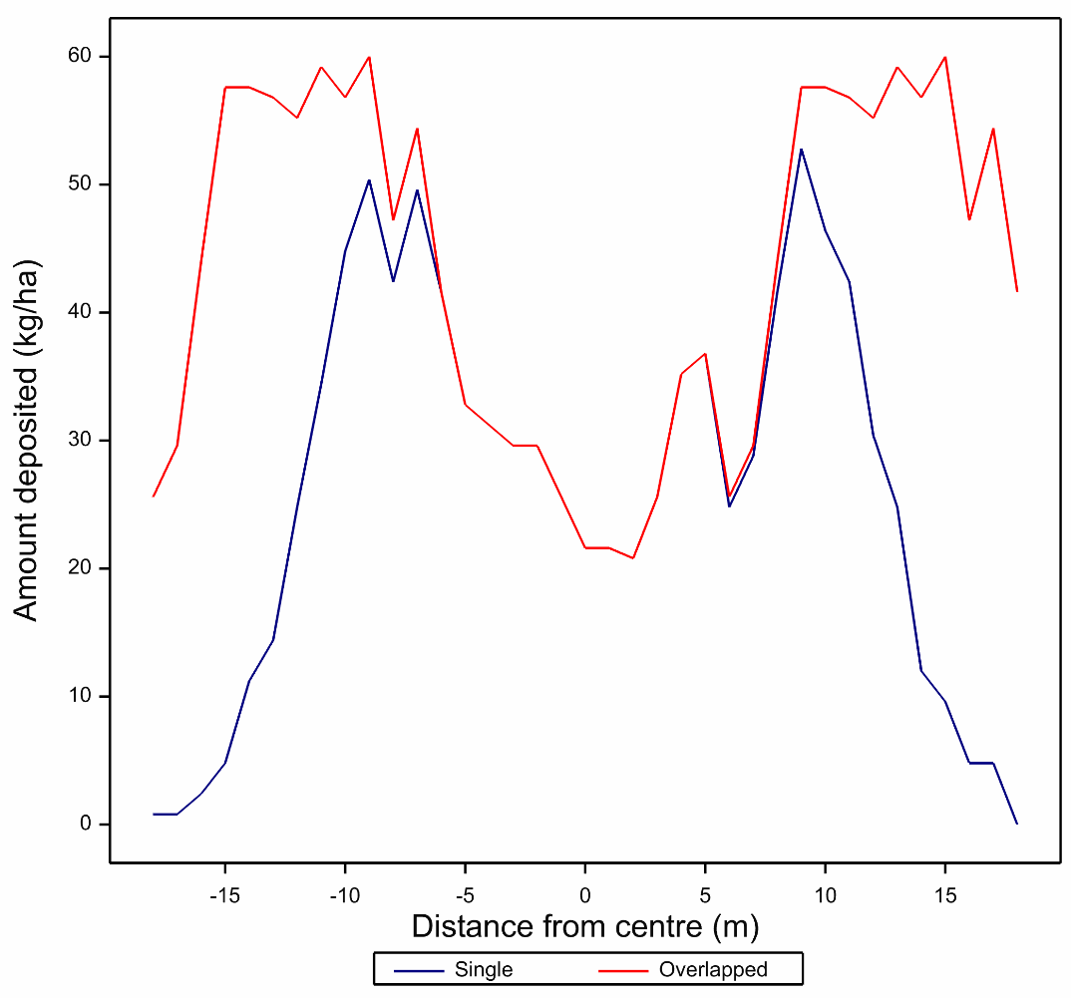
Bad overlap

Slide 16
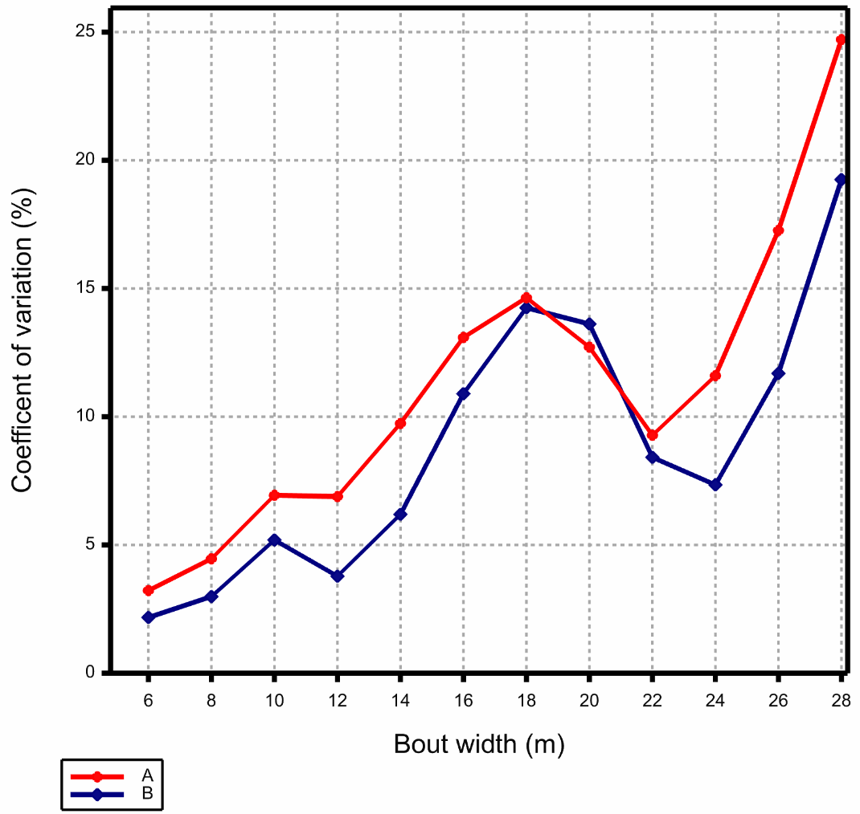
Coefficient of variation vs bout width
Two spreaders with common fertiliser
Optimal bout width is 22-24m until closer spacings of < 12m
Standard bout width is 26 m

Slide 17
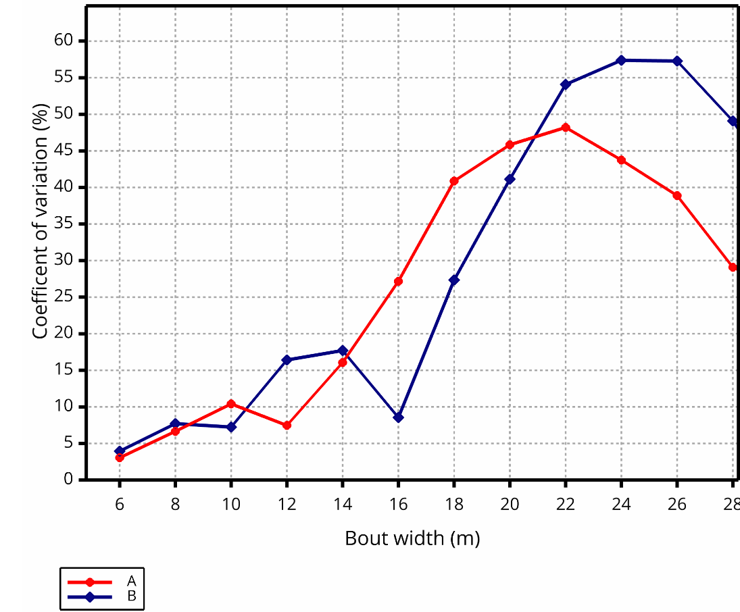
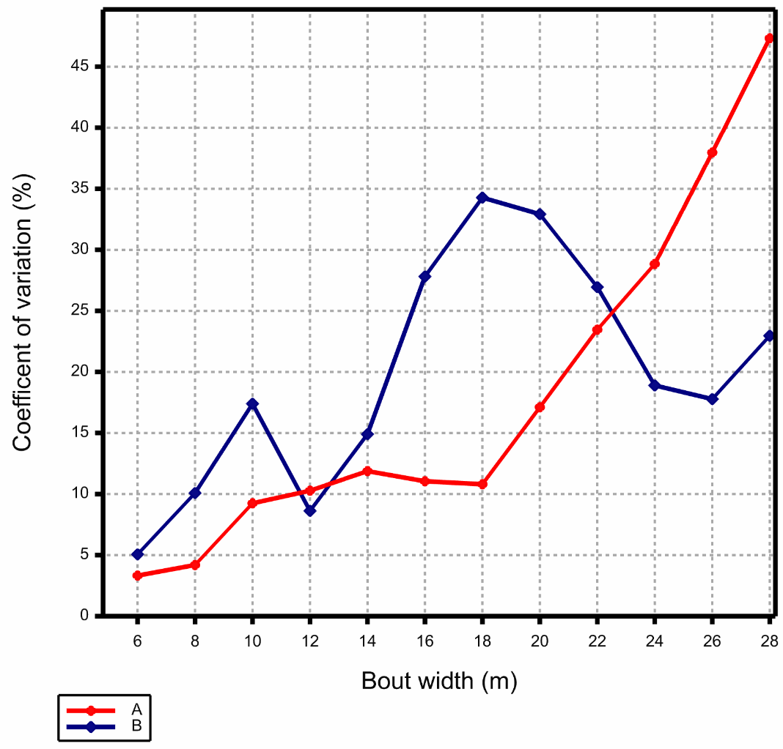
Various patterns depending on fertiliser and spreader

Slide 18
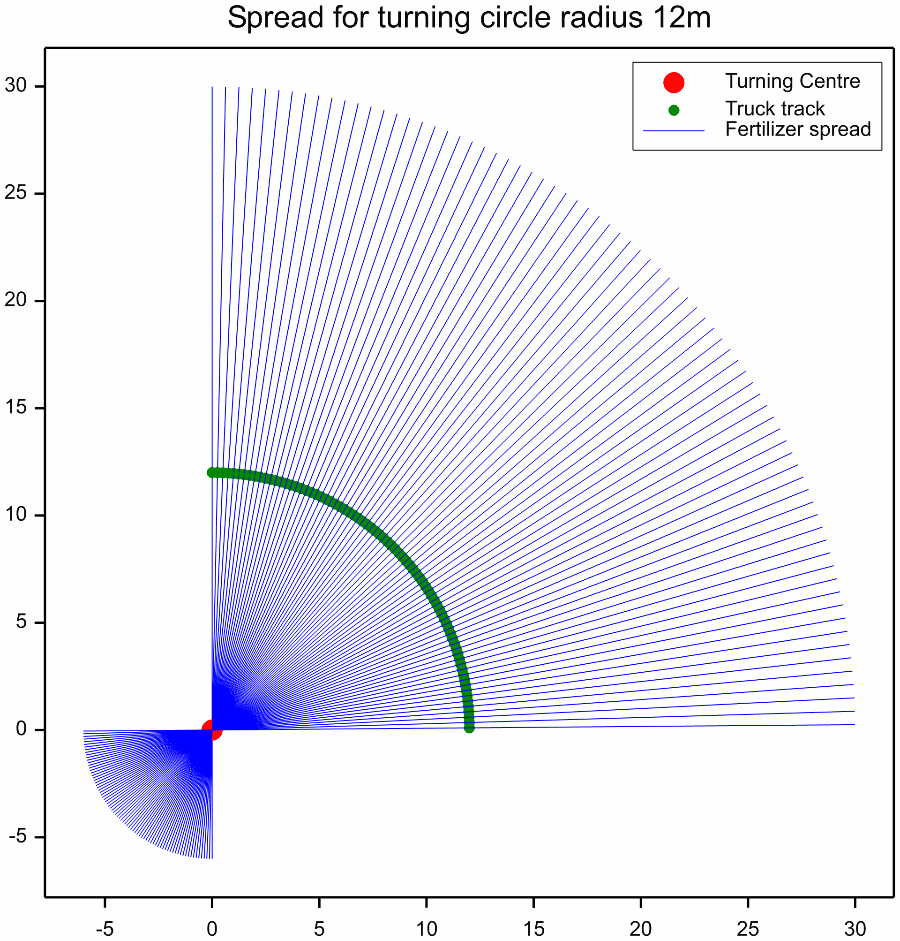
Modelling turn dynamics

Slide 19
Deposition versus radius
Turn radius R, distance from track = d
First order approximation
Outside turning point: rate ∝ 1/(R – d)
Inside turning point: rate ∝ 1/(d - R)
Bounded at close to turning point due to diffusion

Slide 20
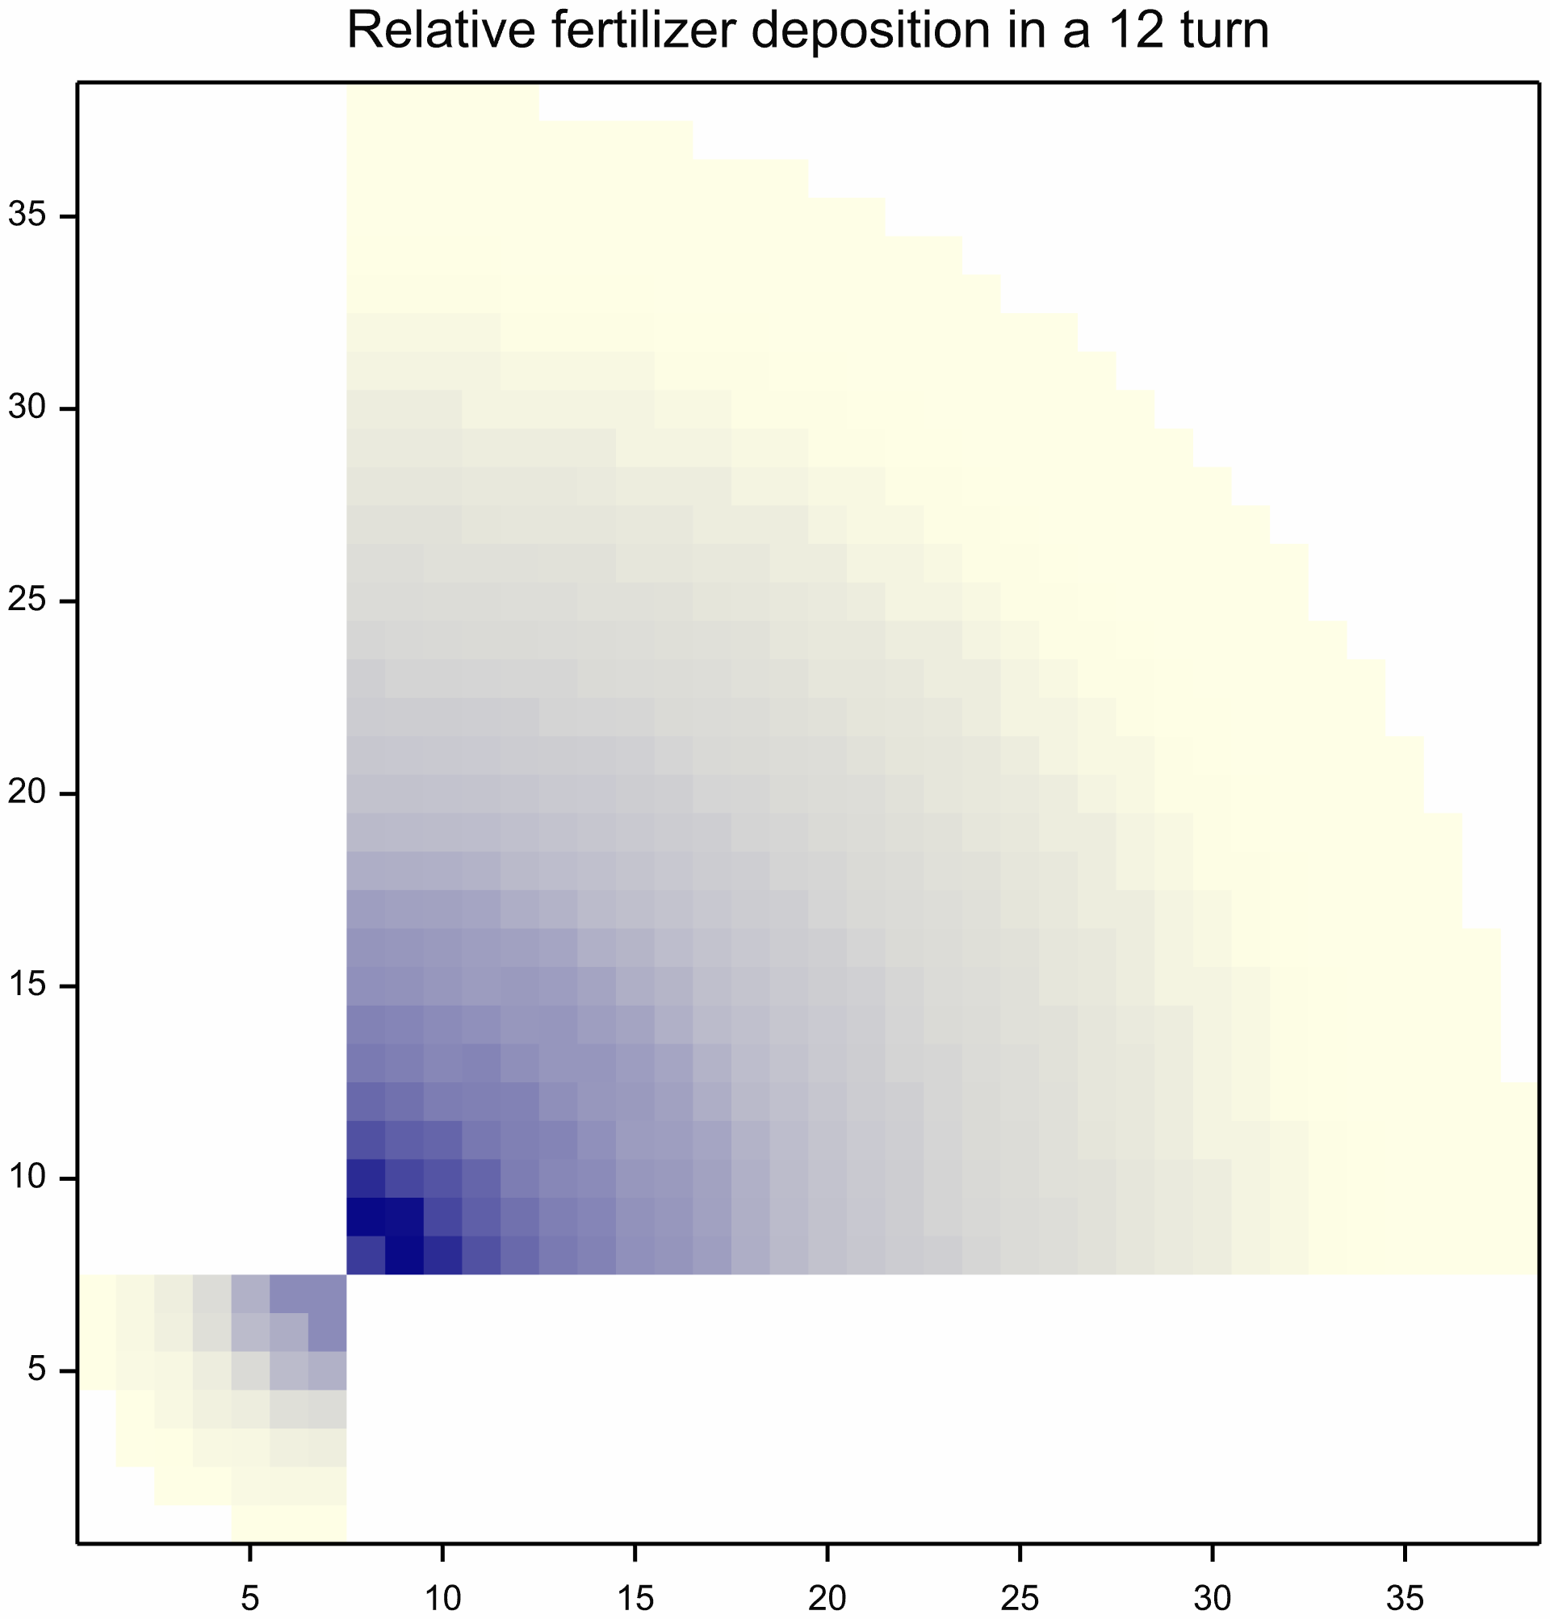
Modelled turn deposition

Slide 21
Putting together whole paddock
Rectangular paddock of given height x width
Set bout width (distance between tracks) for spreader
Spiral track at starting at one corner
Selected fertiliser profile
Positions -1,1 interpolated from -2,0,2 values
Paddock grid of 1m squares
Combine linear and turn distributions

Slide 22
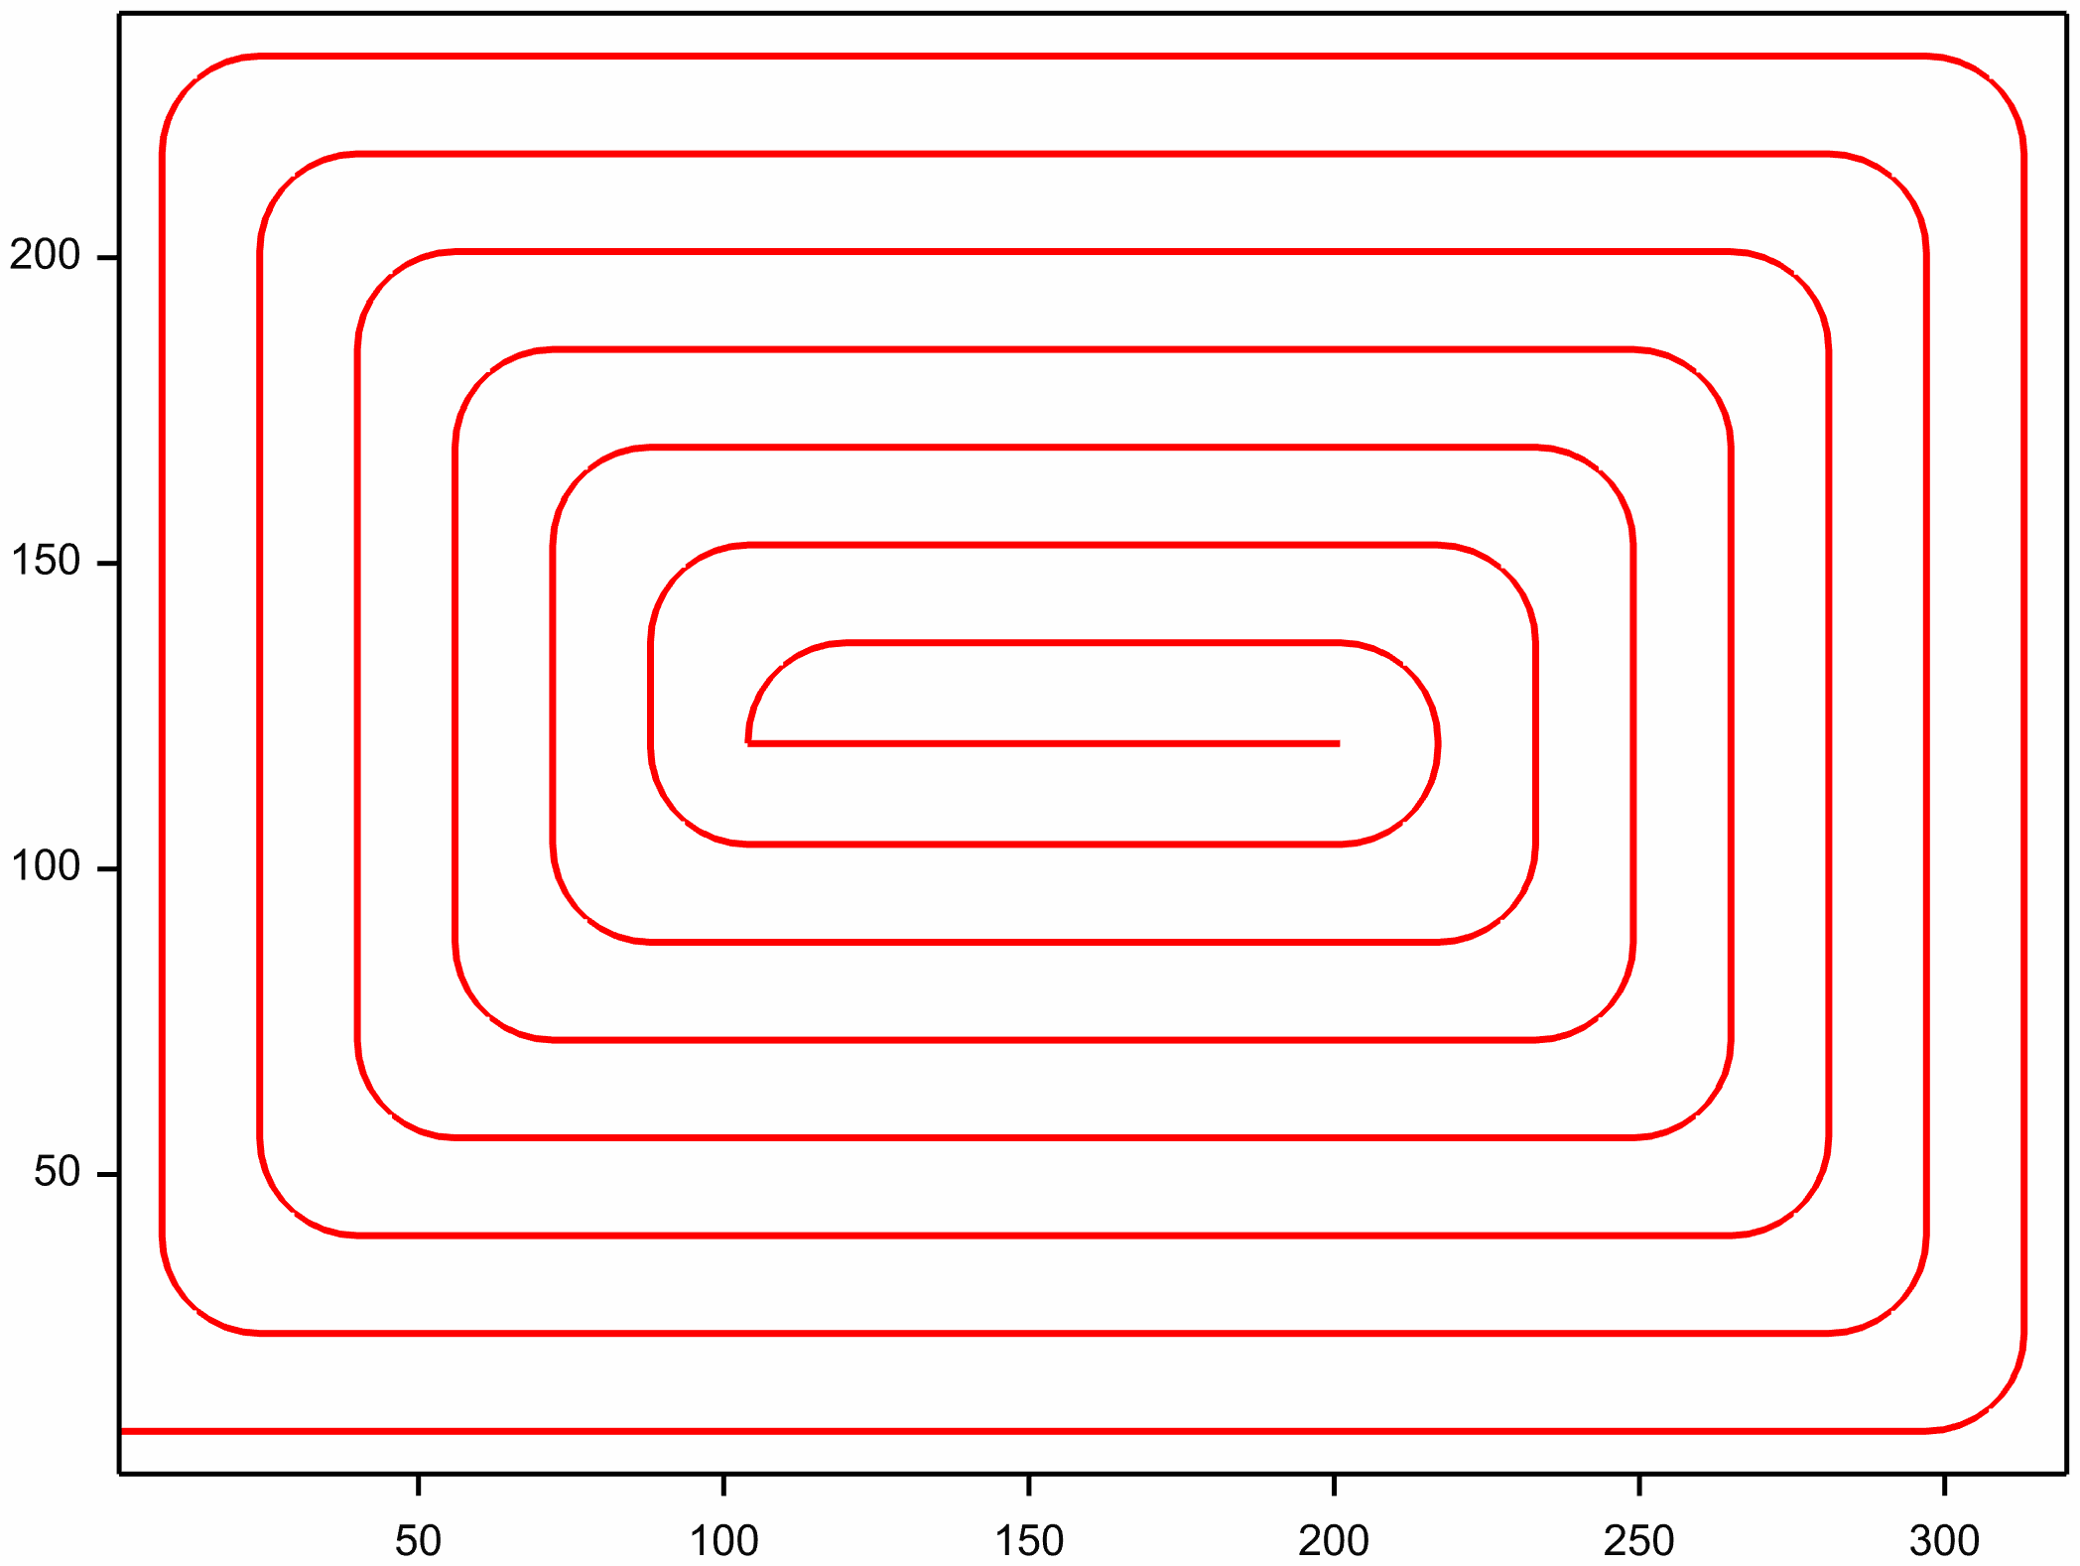
Track 320x240 m paddock

Slide 23
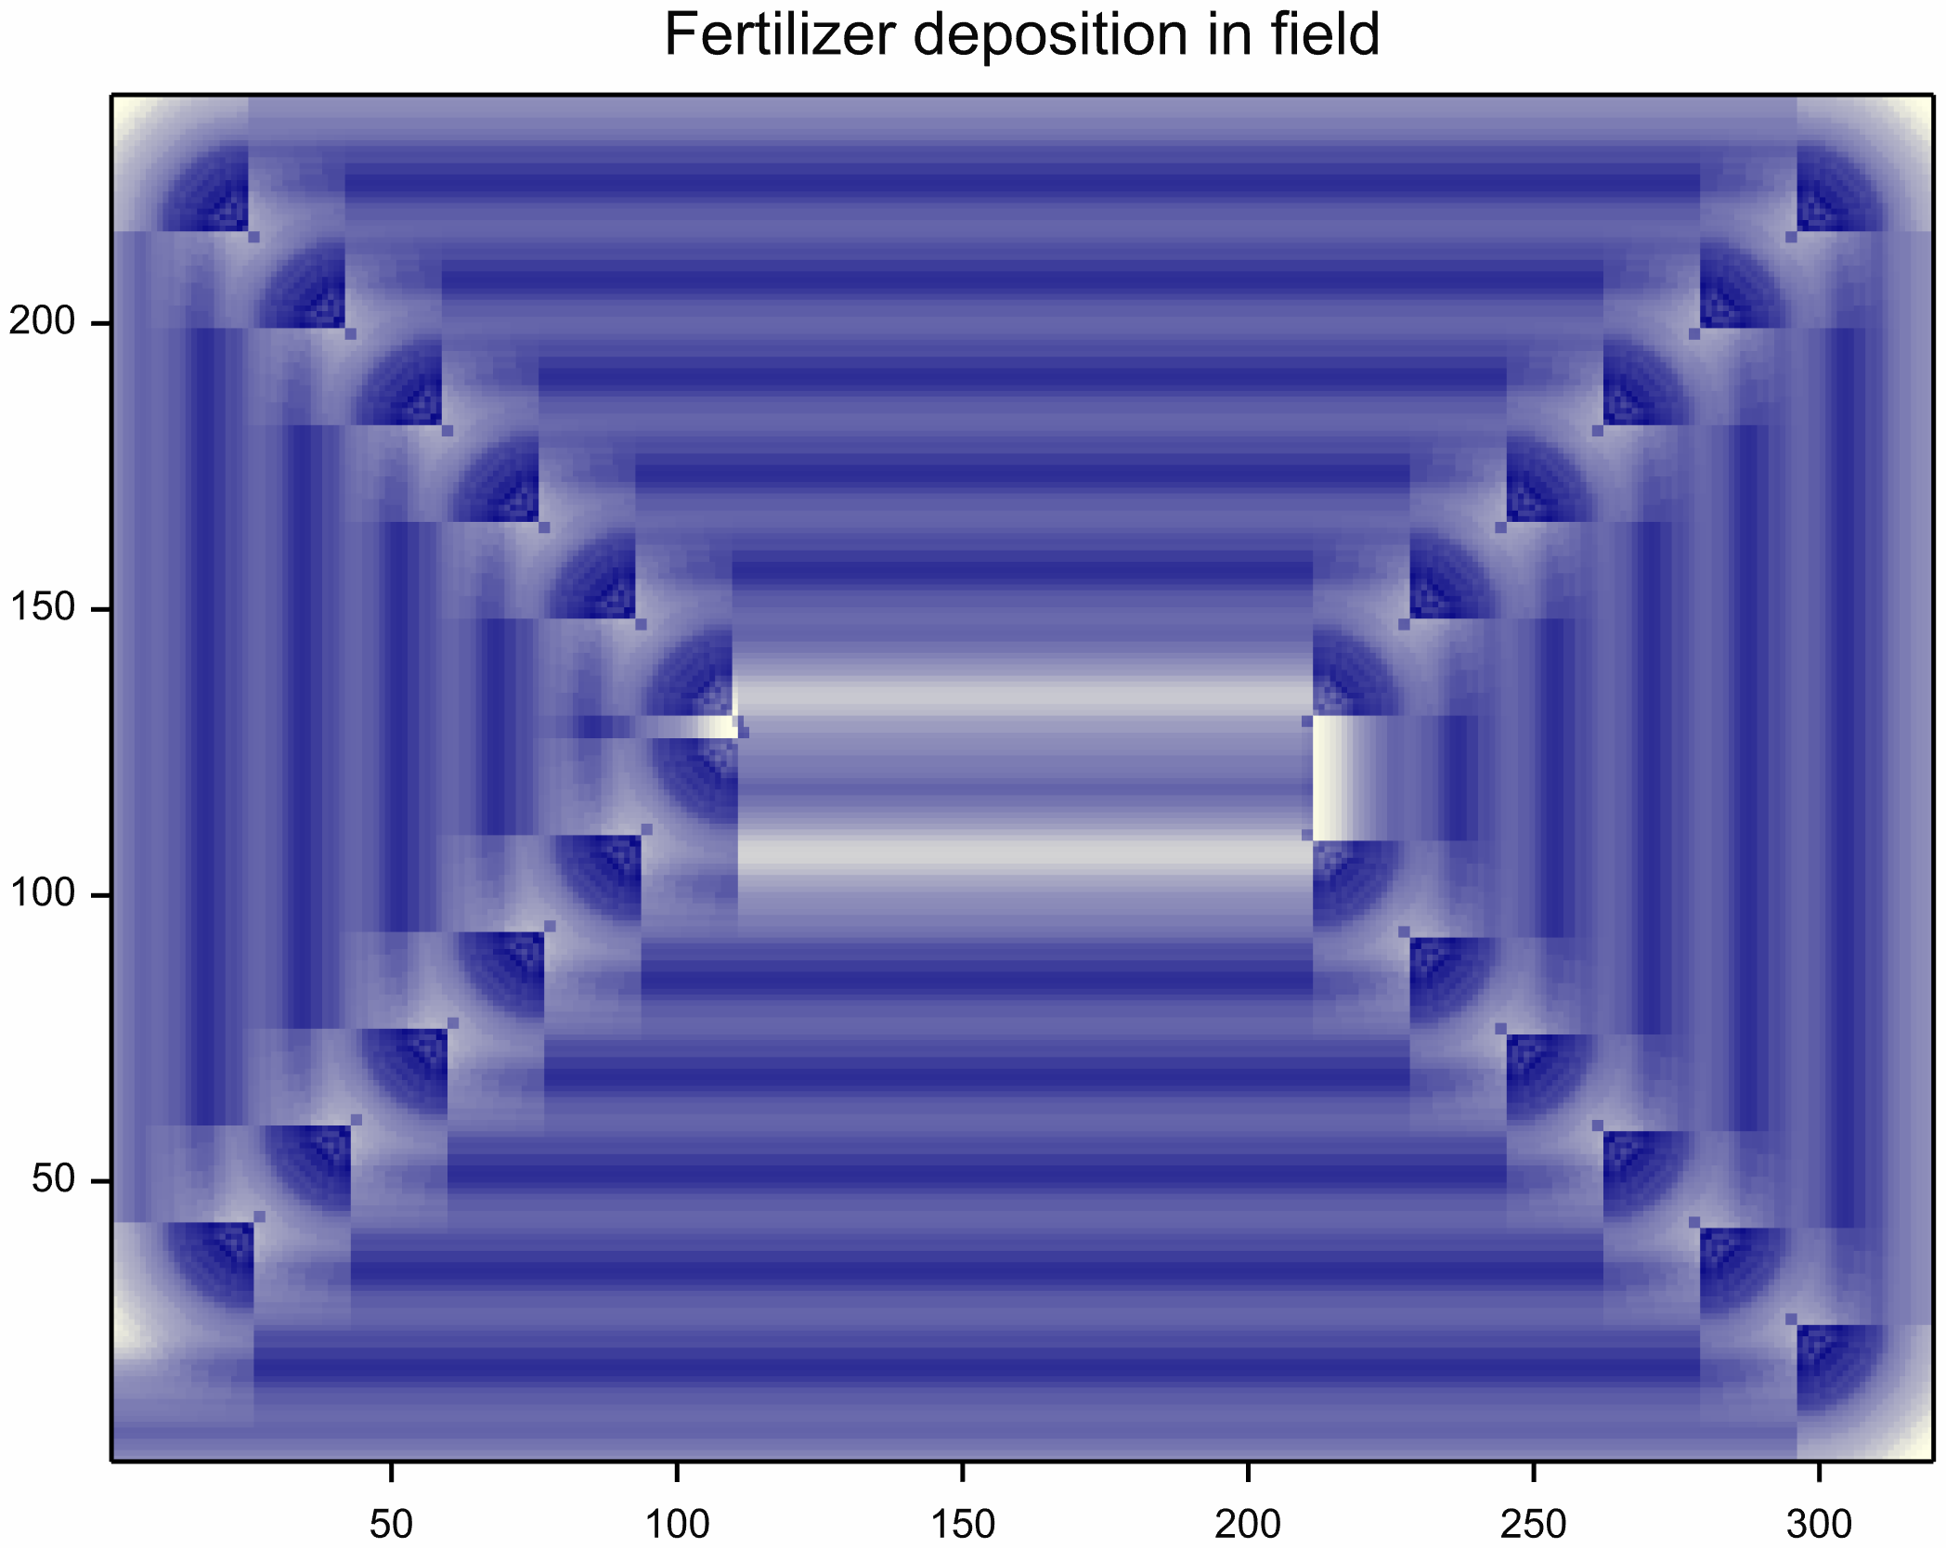
Modelled spatial distribution

Slide 24
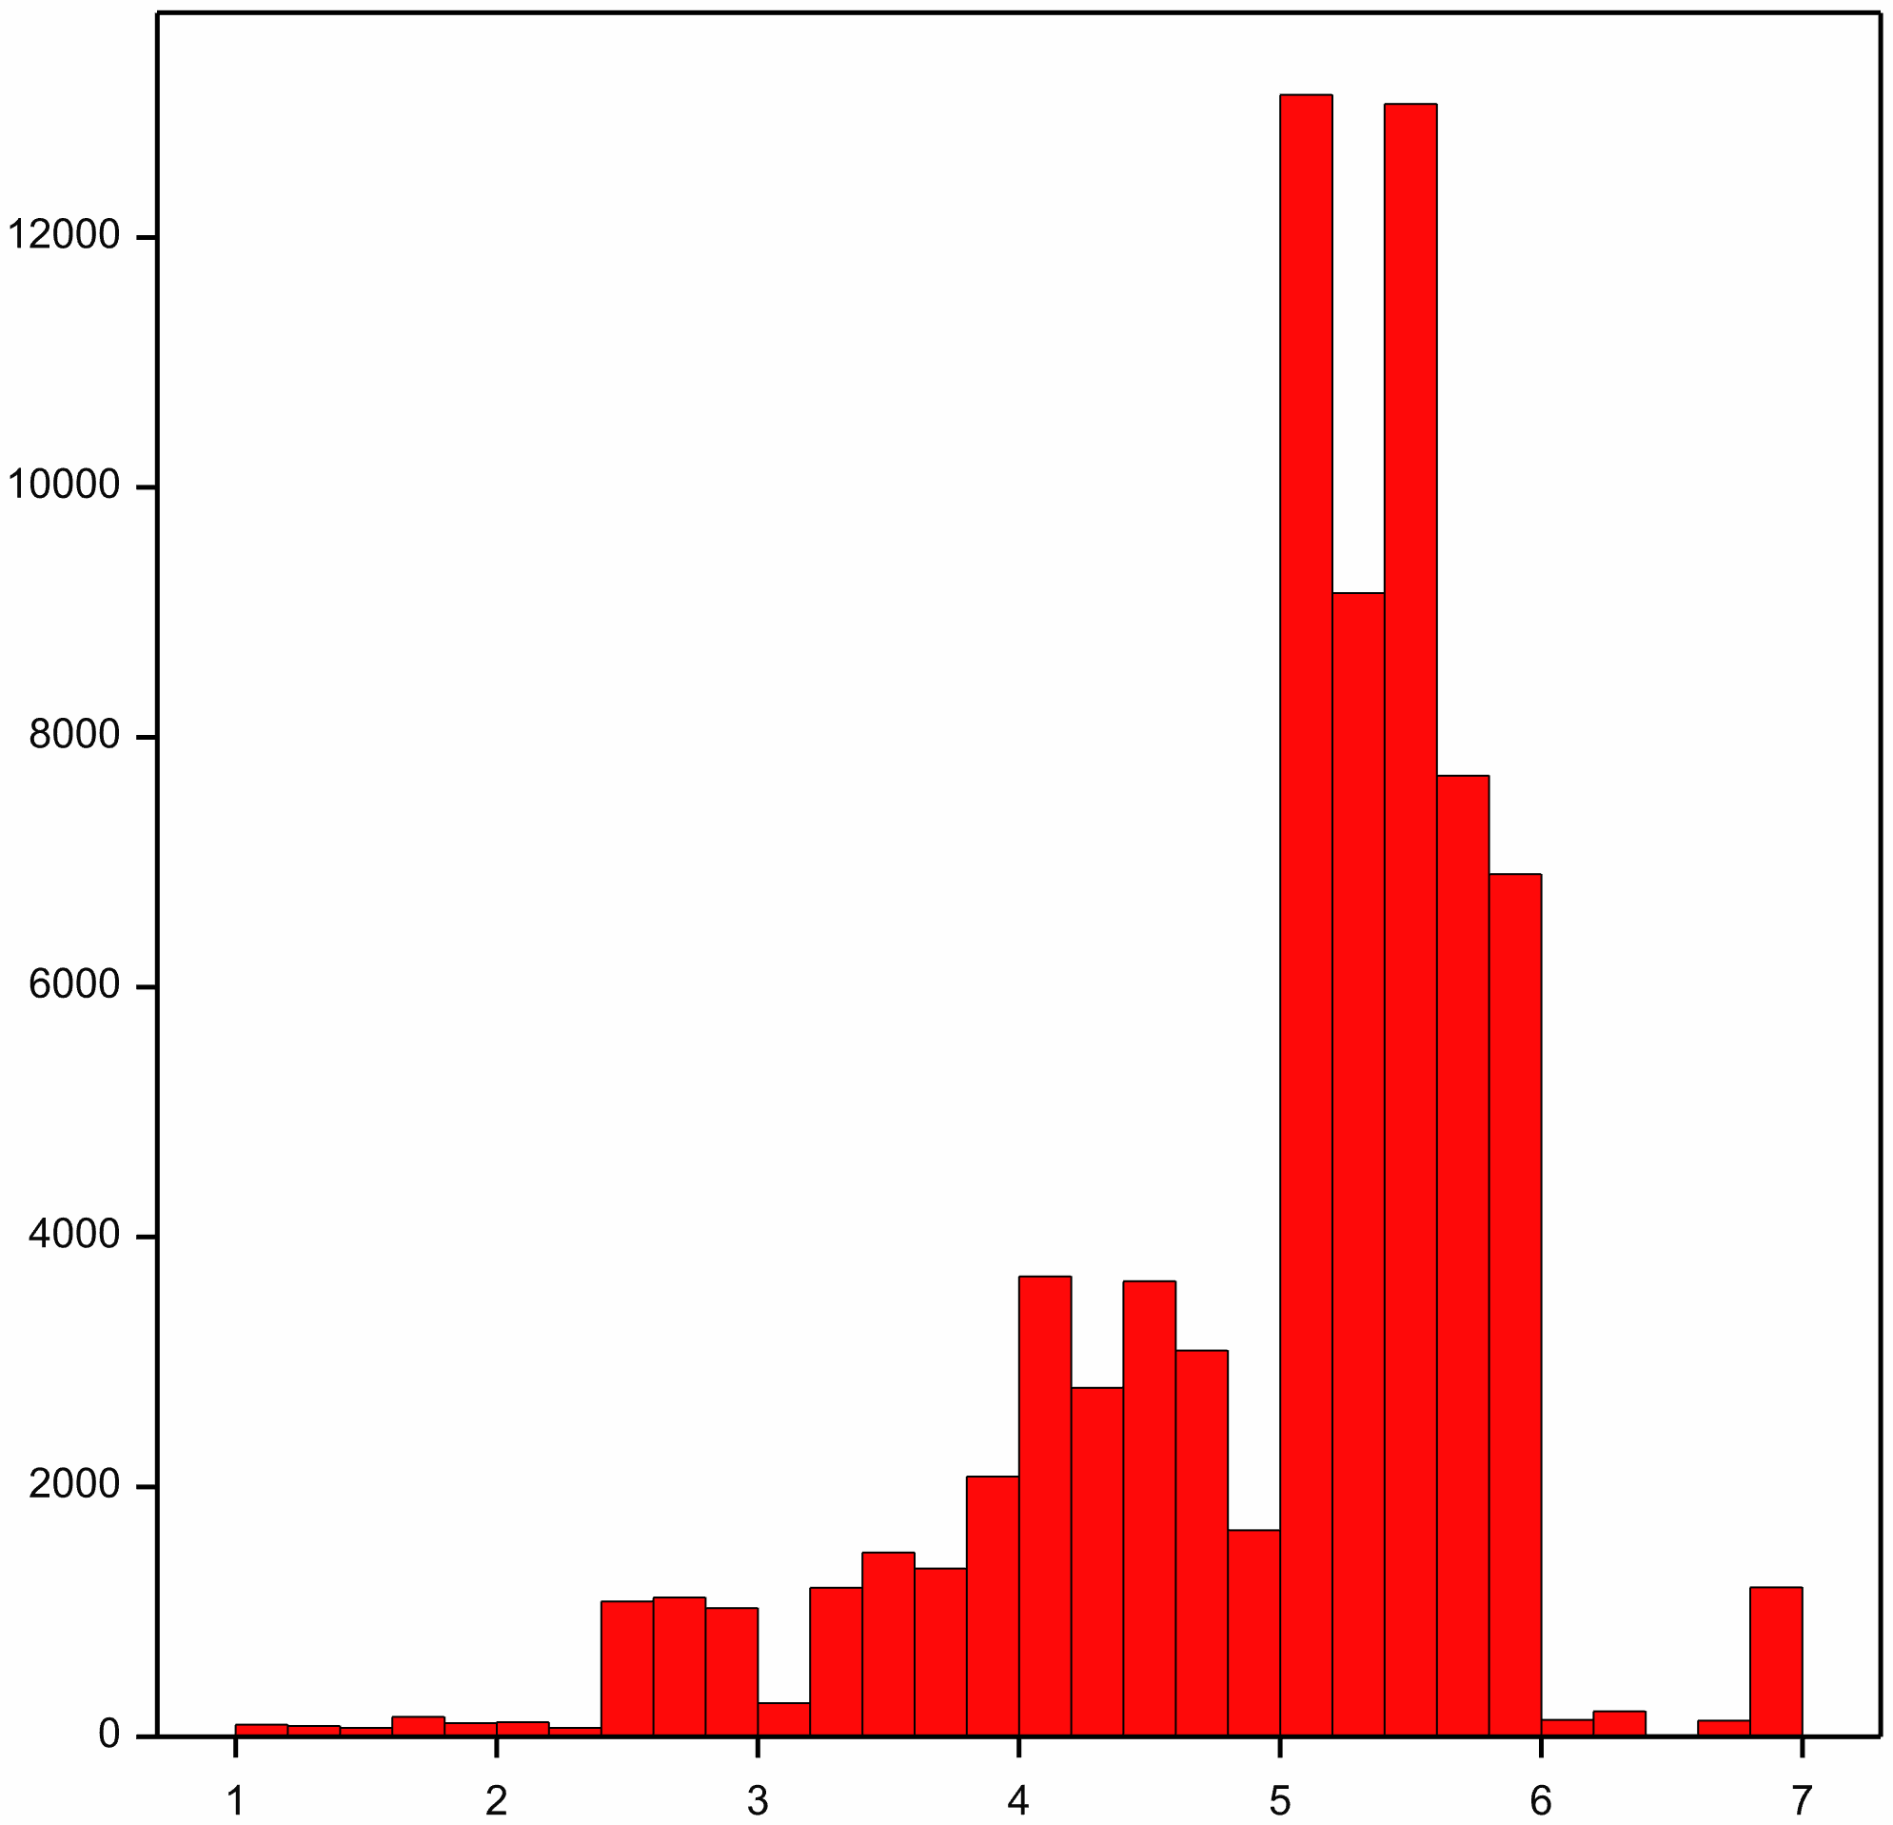
Histogram of deposition
Values > 7 grouped in last bar

Slide 25
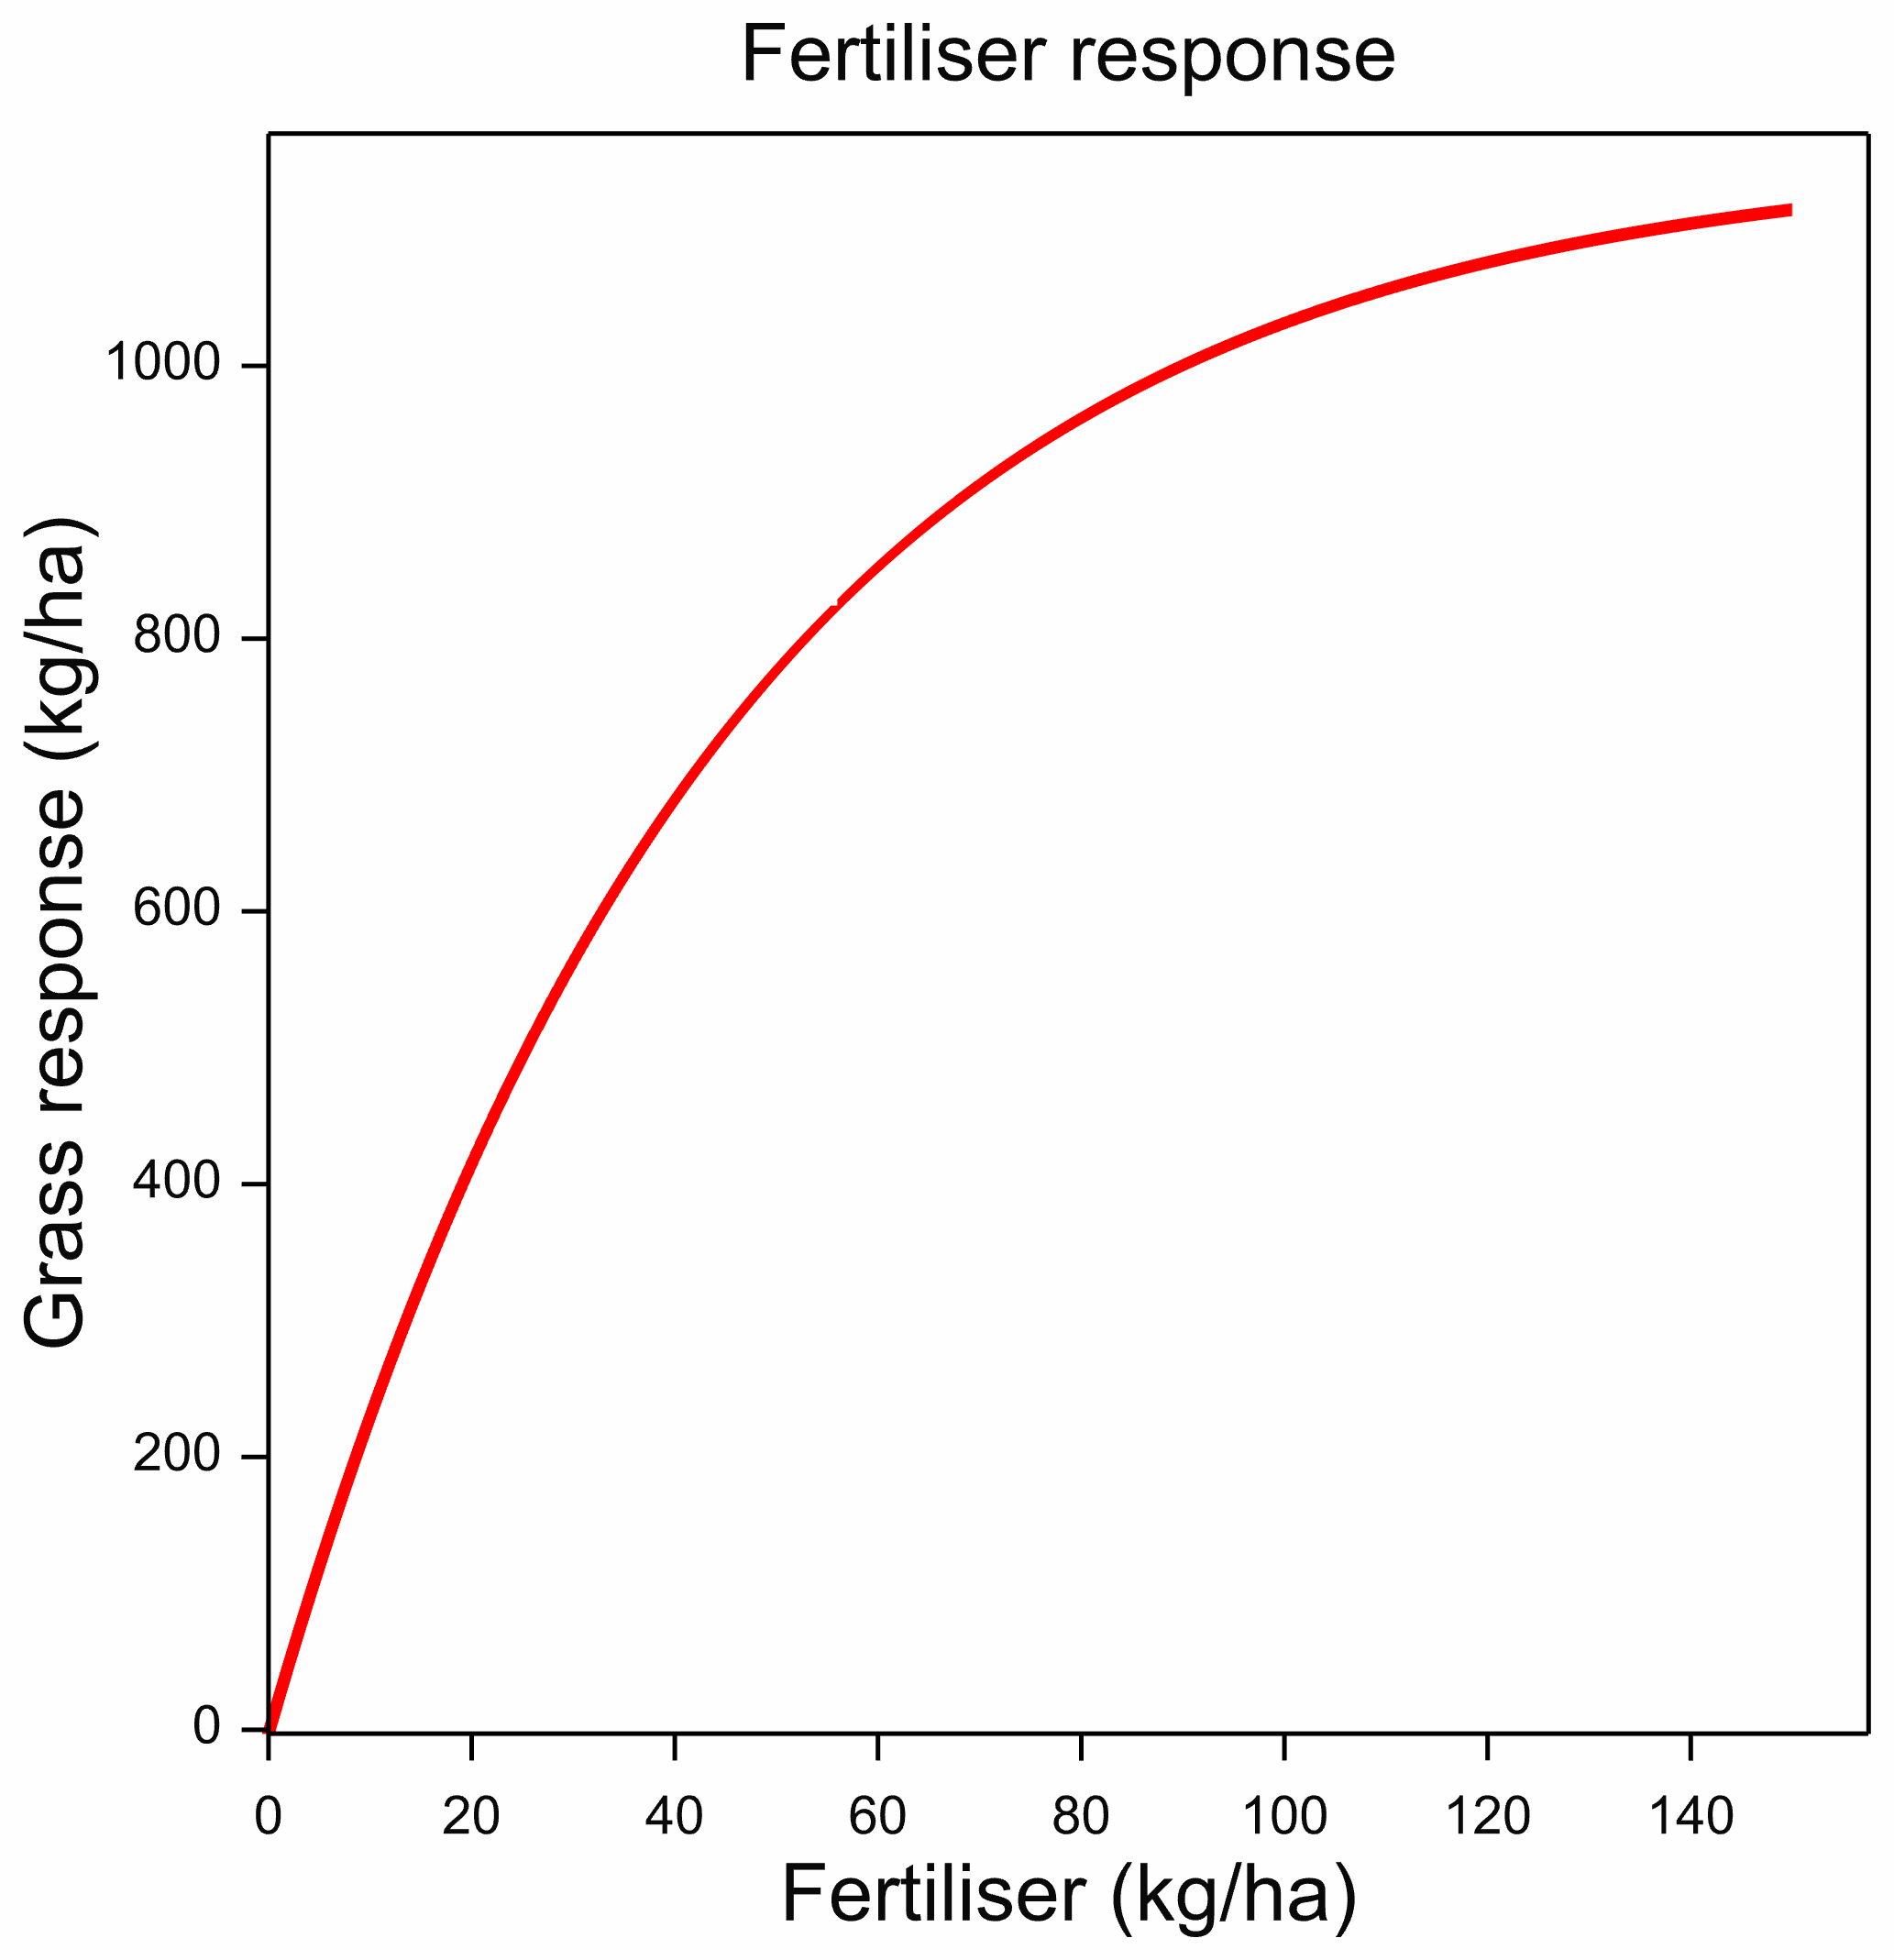
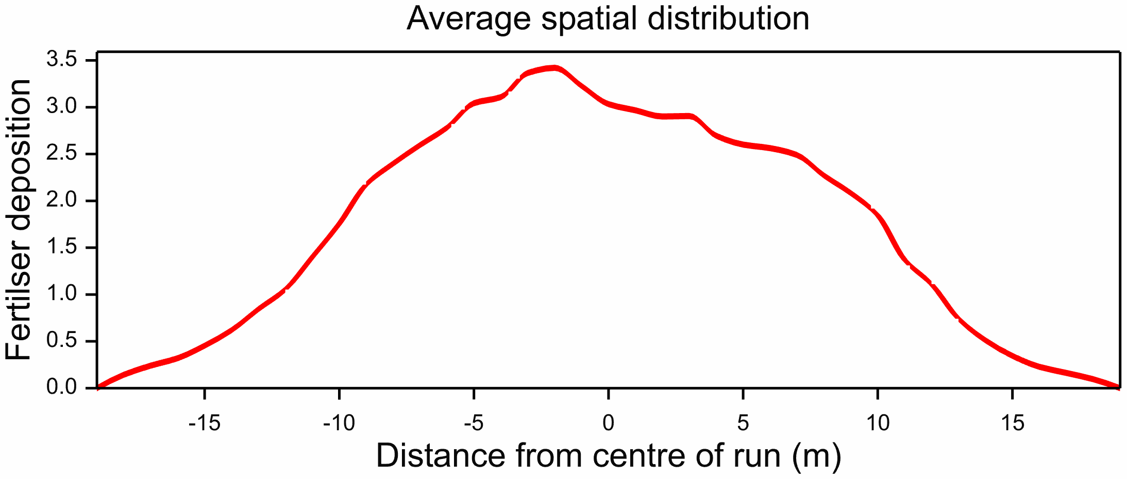
Economic optimization
Find optimal bout width for grass growth vs cost
Grass value $ 0.58 / kg (spring)
Cost $ 200 / hour for truck
Fertiliser response curve
Applying average 80 kg/ha
Used with average distribution over fertilisers

Slide 26
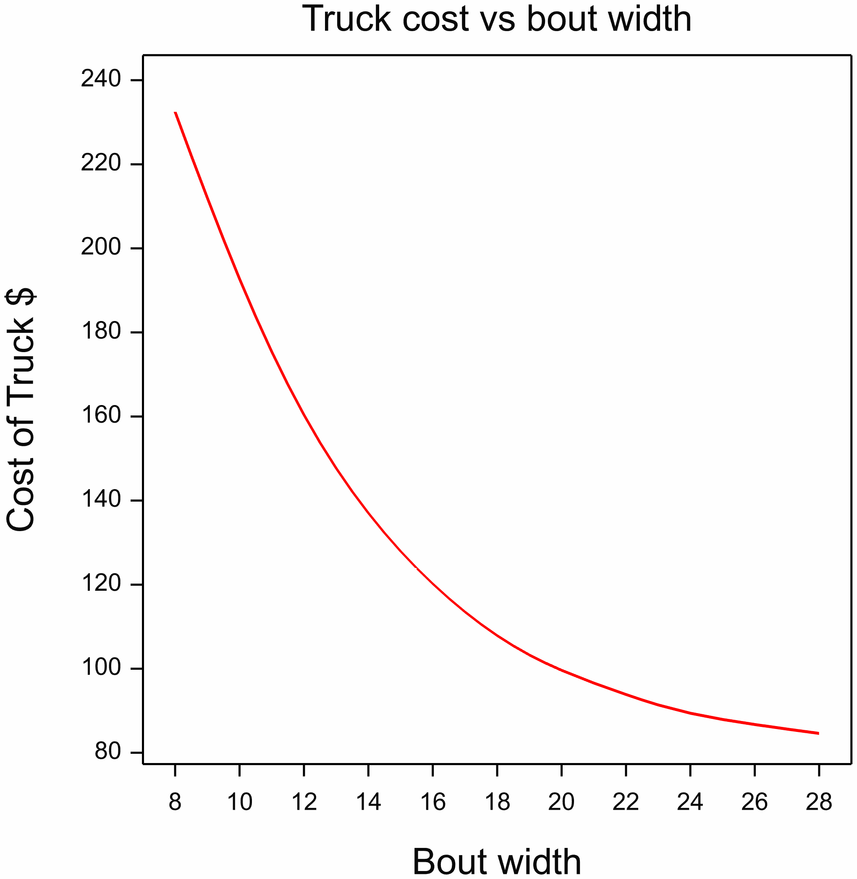
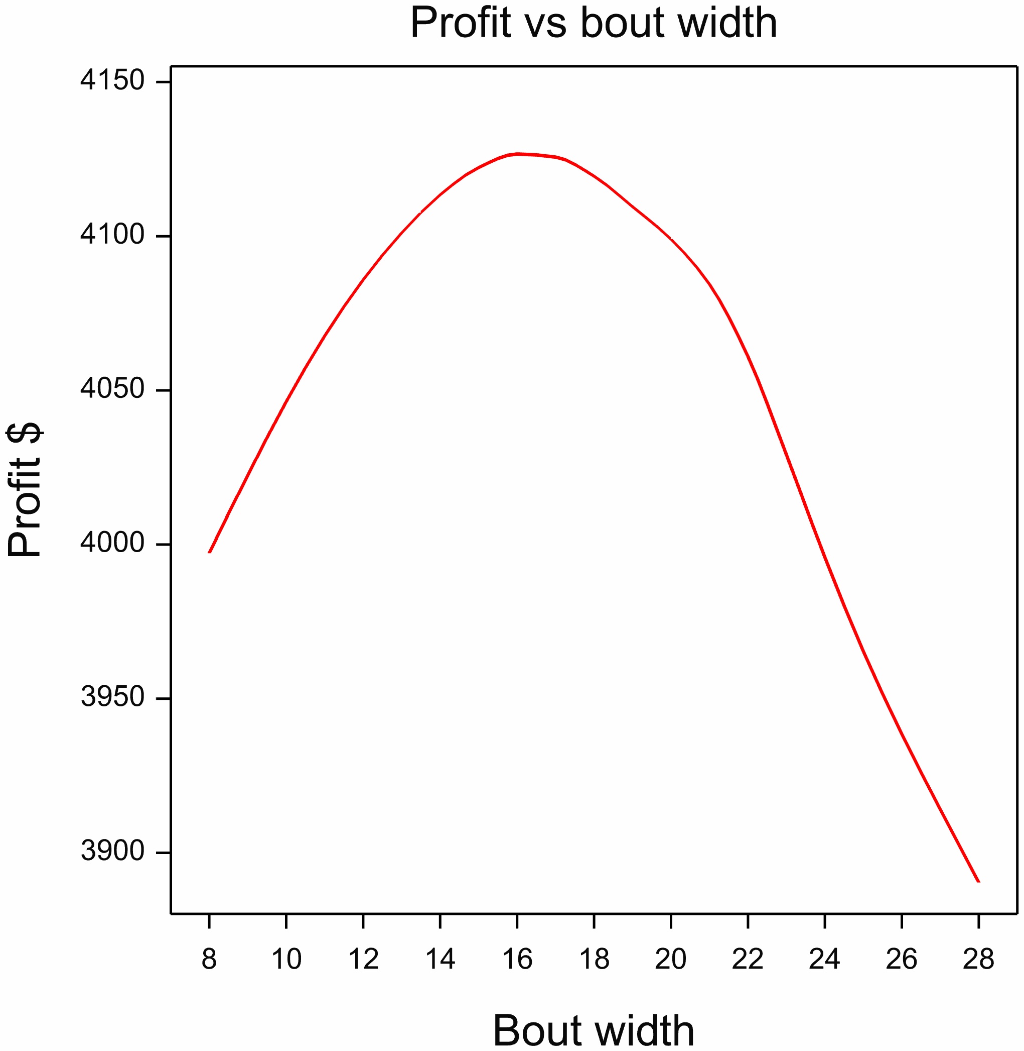
Economic Results
Optimum profit at 16-18 m

Slide 27
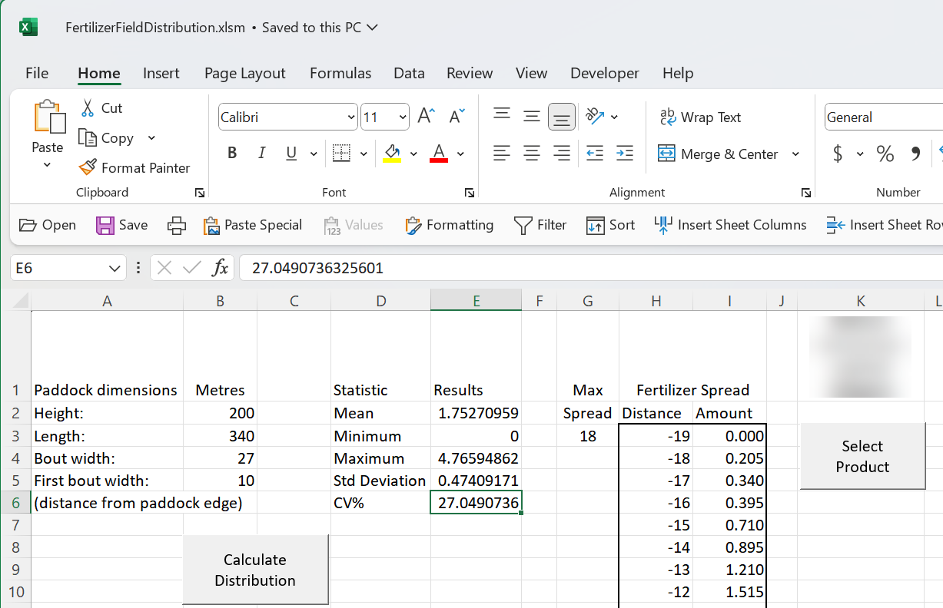
Model put into Excel file for farmers

Slide 28
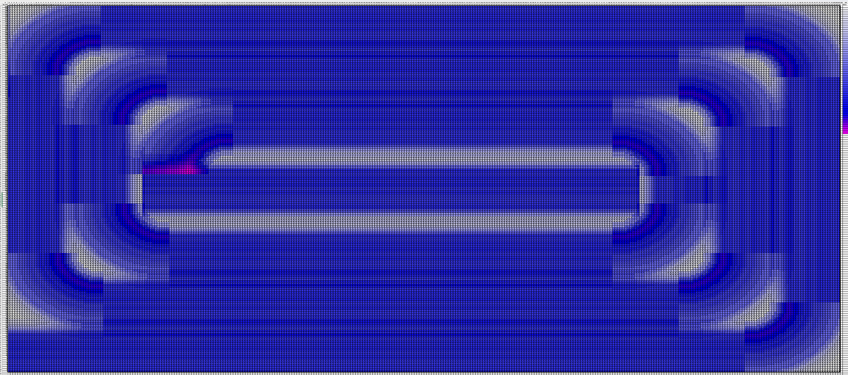
Spatial plot using coloured cells

Slide 29
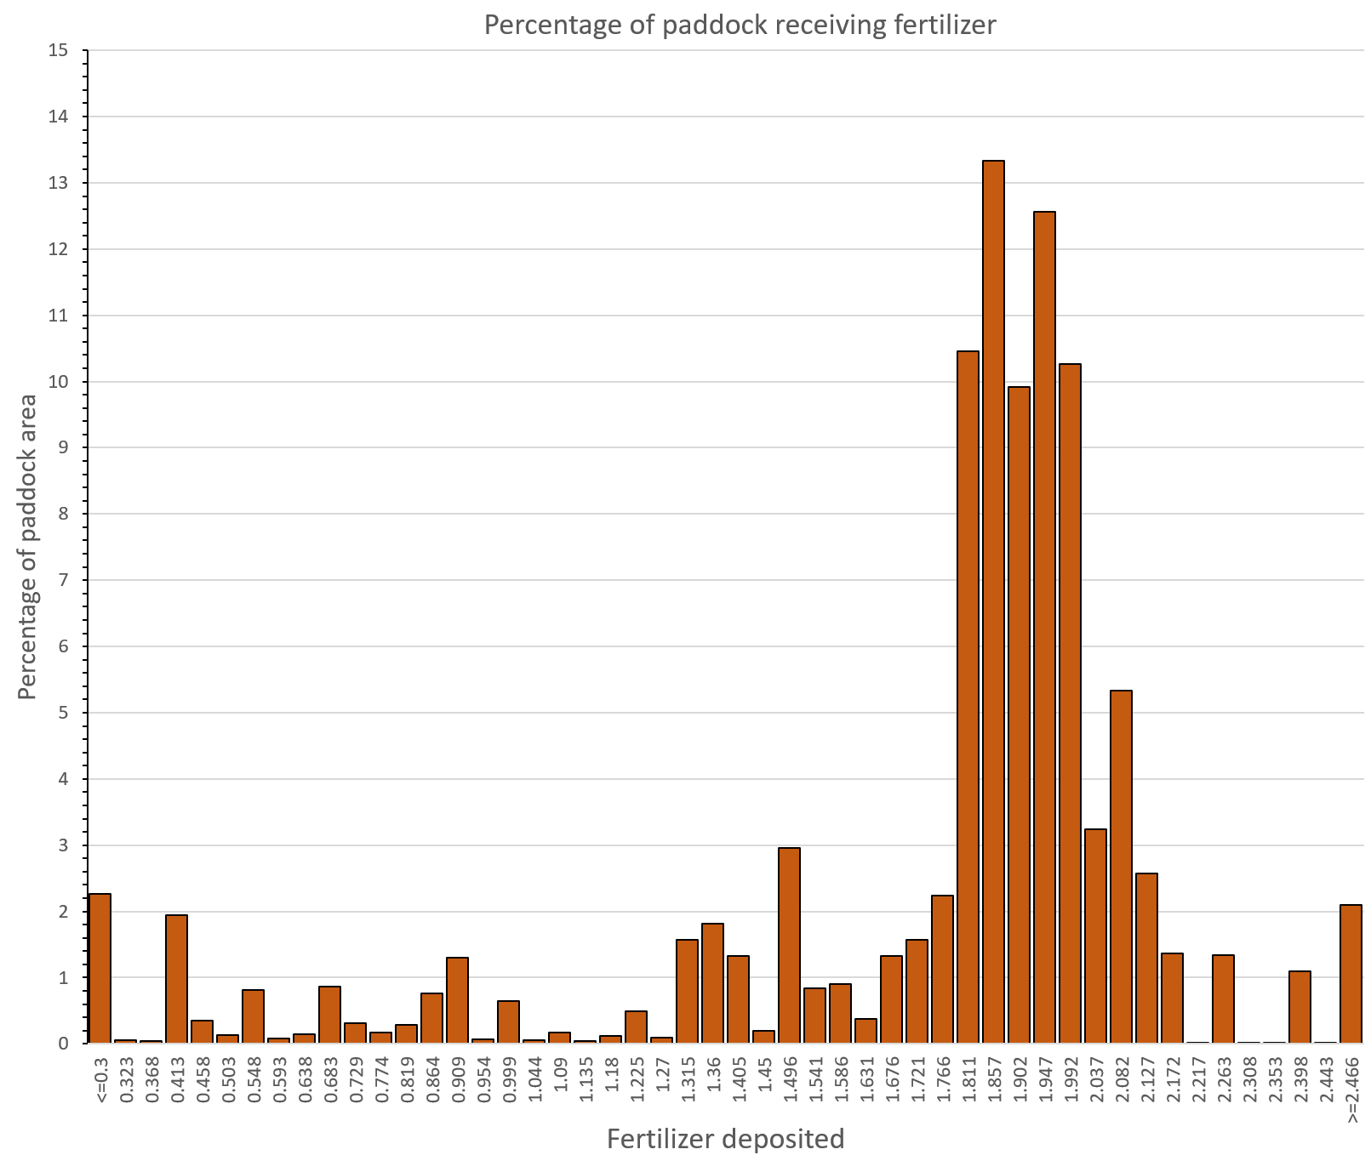
Histogram of coverage

Slide 30
